Slide 1
Nancy Rourke Expressionist Paintings
Established in 2007.
‘My eyes and my hands come together to create visual expression. Therefore, I paint from what I see, feel and know.’

Slide 2
This is my art studio.
I have five easels and sometimes, I work with five different paintings a day.

Slide 3
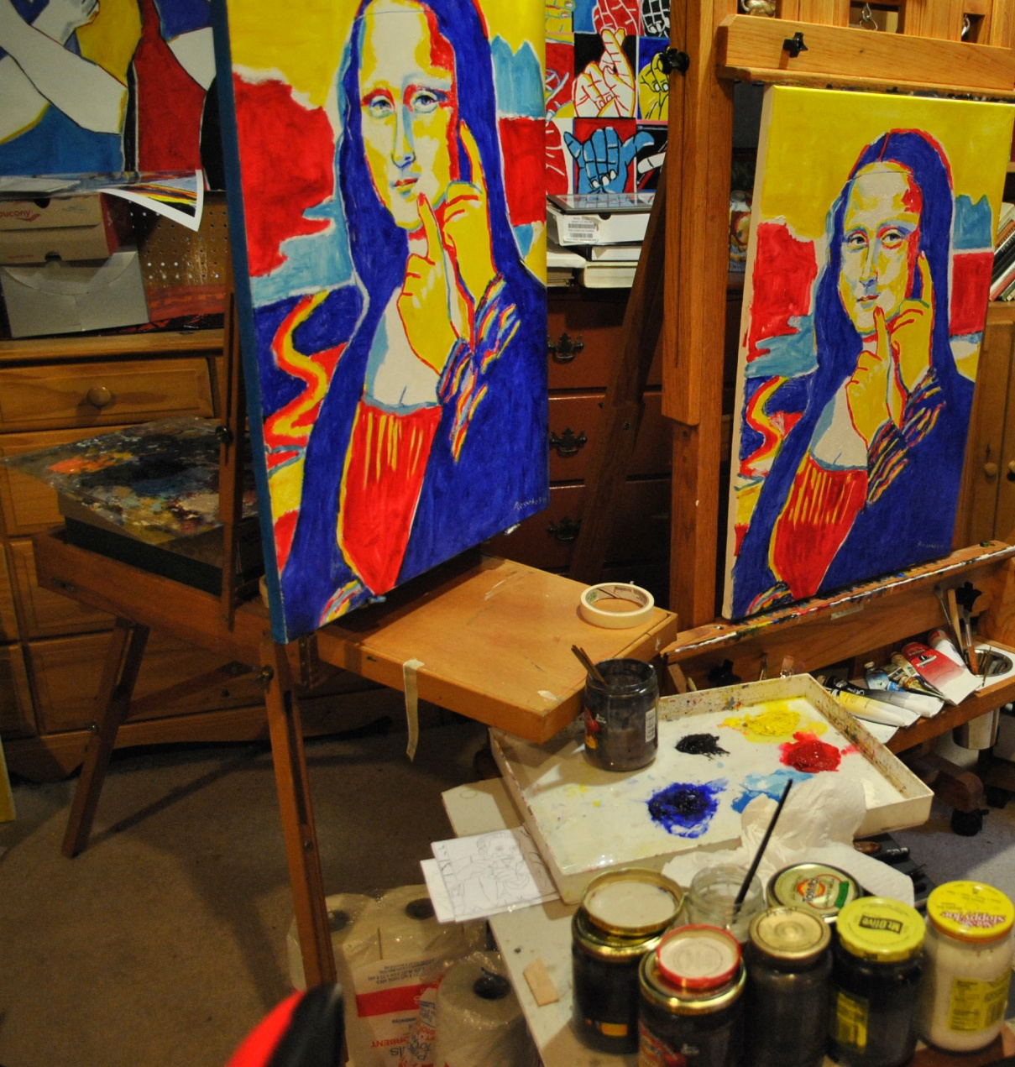

Slide 4
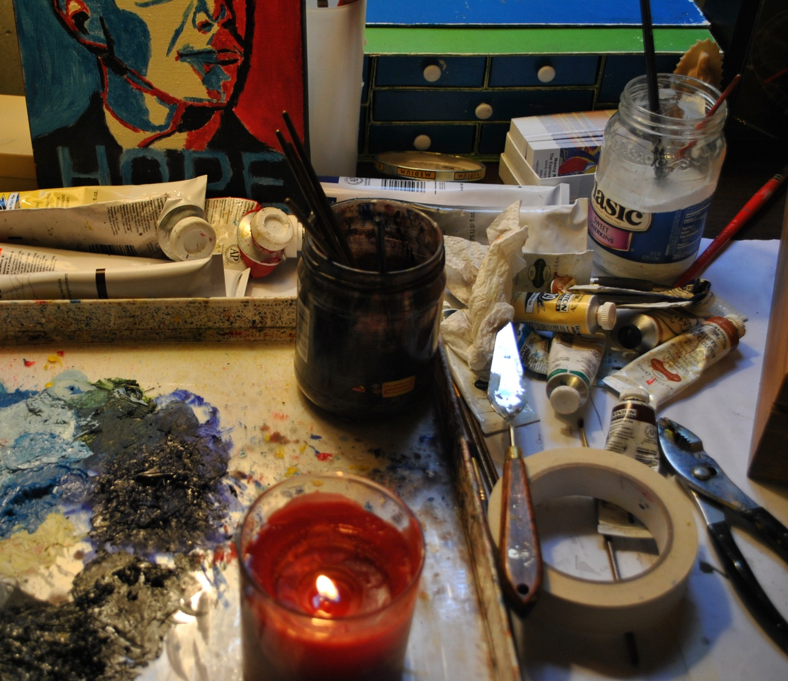

Slide 5
“Audism” 20x30inch Oil on Canvas inside KISSFIST 2010 June Issue

Slide 6
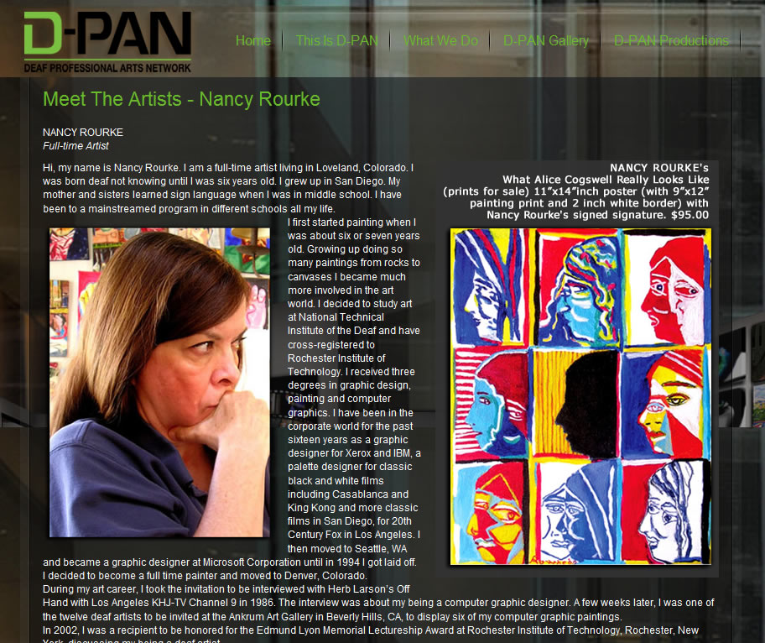
My article inside D-PAN Deaf Professional Artists Network 2010

Slide 7
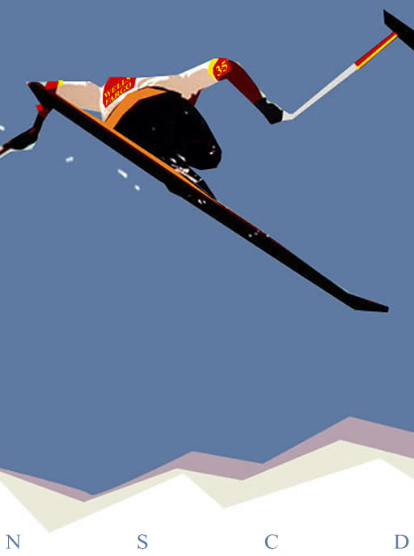
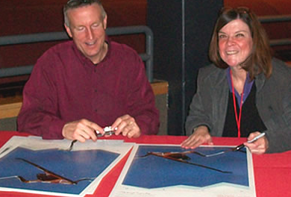
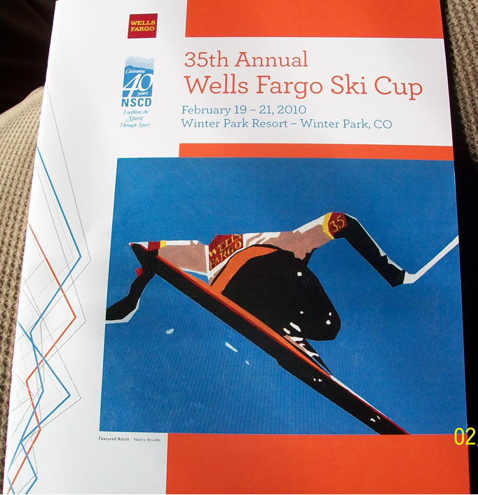
Featured Artist of the Wells Fargo Ski Cup 2010 at Winter Park, Colorado
18x24 Oil Painting
‘Ski Up
High’
Sponsored
By
National
Sports
Center
of the
Disabled

Slide 8
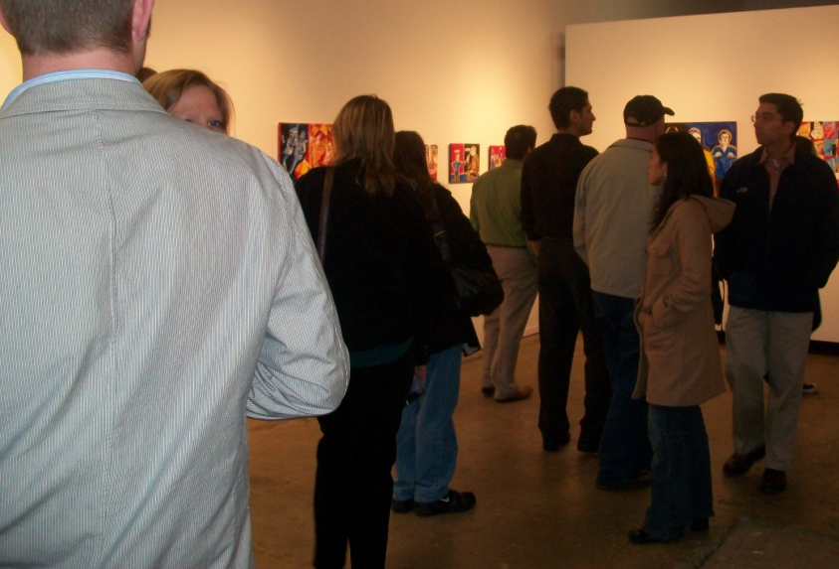
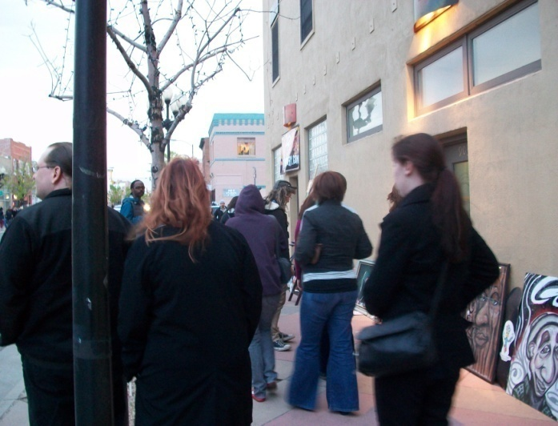
My Solo Show in Denver, CO
This is my Gallery Curator, Damon McLeese.

Slide 9
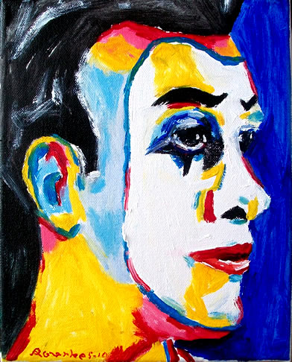
At the World Deaf Expo 2010

Slide 10
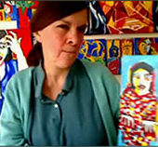
My paintings/videos at Deaf Studies Digital Journal 2010-11

Slide 11
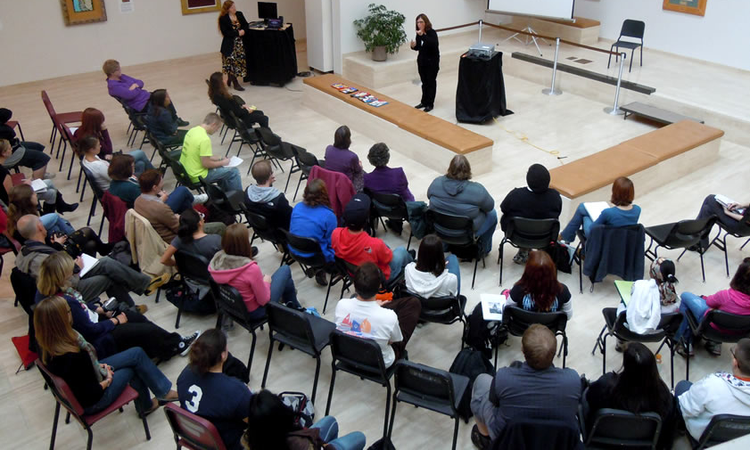
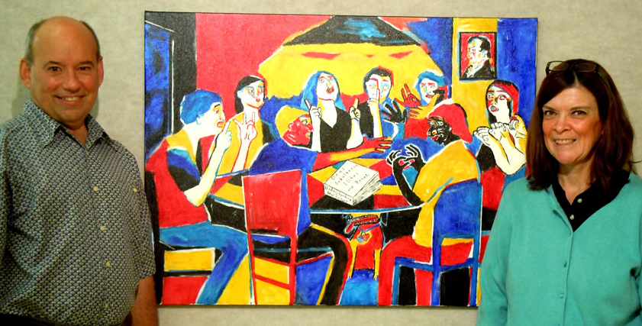
My Solo Show in Rochester, NY

Slide 12
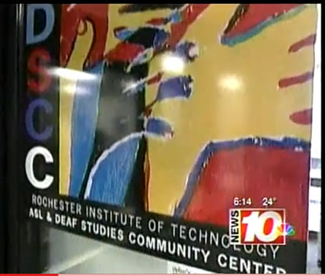
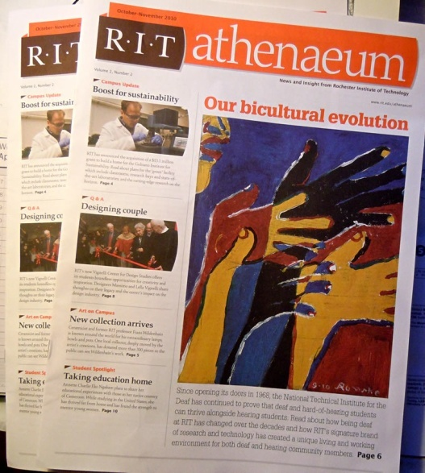
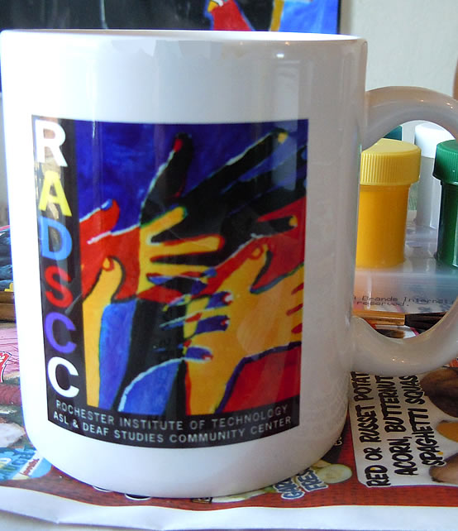
My painting becomes a logo at RIT

Slide 13
My Artists Panel during the Denver Arts Week 2010

Slide 14
Paintings in a magazine.

Slide 15
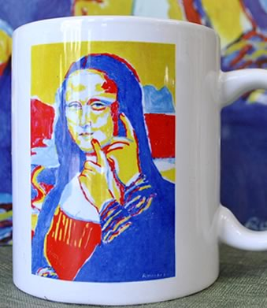
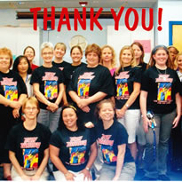
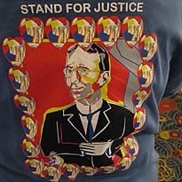
Paintings in mugs and tshirts

Slide 16
My Biography

Slide 18
1963
Raised in San Diego; my parents did not know
I was Deaf until I was six years old.

Slide 19
1963
Raised in San Diego; my parents did not know
I was Deaf until I was six years old.
Doctor thought I had learning disability
and speech impairment. Not so.

Slide 20
1963
Raised in San Diego; my parents did not know
I was Deaf until I was six years old.
Doctor thought I had learning disability
and speech impairment. Not so.
Started painting at age seven.
1964

Slide 21
1963
Raised in San Diego; my parents did not know
I was Deaf until I was six years old.
Doctor thought I had learning disability
and speech impairment. Not so.
Started painting at age seven.
Painted and exhibited from rocks to canvases
at art fairs, art contests and galleries.
1964
1966

Slide 22
1963
Raised in San Diego; my parents did not know
I was Deaf until I was six years old.
Doctor thought I had learning disability
and speech impairment. Not so.
Started painting at age seven.
Painted and exhibited from rocks to canvases
at art fairs, art contests and galleries.
In high school, I wanted to be an artist.
1964
1966
1973

Slide 23
1963
Raised in San Diego; my parents did not know
I was Deaf until I was six years old.
Doctor thought I had learning disability
and speech impairment. Not so.
Started painting at age seven.
Painted and exhibited from rocks to canvases
at art fairs, art contests and galleries.
In high school, I wanted to be an artist.
Went to art school at NTID/RIT and attained
a MFA in Computer Graphic Design/Painting
in 1986.
1964
1966
1973
1977

Slide 24
1979
Exhibited my first Deaf Artists show at
National Gallery of Art in Washington, DC.

Slide 25
1979
Exhibited my first Deaf Artists show at
National Gallery of Art in Washington, DC.
Became one of the Twelve Deaf Artists at
‘Heart, Eye, Hand’ exhibit at the Ankrum
Gallery in Los Angeles, CA.
1986

Slide 26
1979
Exhibited my first Deaf Artists show at
National Gallery of Art in Washington, DC.
Became one of the Twelve Deaf Artists at
‘Heart, Eye, Hand’ exhibit at the Ankrum
Gallery in Los Angeles, CA.
I stopped painting and worked as a temporary
graphic designer for Xerox in San Diego, CA.
1986
1987

Slide 27
1979
Exhibited my first Deaf Artists show at
National Gallery of Art in Washington, DC.
Became one of the Twelve Deaf Artists at
‘Heart, Eye, Hand’ exhibit at the Ankrum
Gallery in Los Angeles, CA.
I stopped painting and worked as a temporary
graphic designer for Xerox in San Diego, CA.
Became a palette designer for 20th Century
Fox, and created colors for classic black &
white films: Casablanca, King Kong, Sherlock
Holmes, etc.
1986
1987
1988

Slide 28
1989
I quit the filming job.

Slide 29
1989
I quit the filming job.
Moved to Seattle, WA and worked as a graphic
designer for Microsoft Corporation.
1990

Slide 30
1989
I quit the filming job.
Moved to Seattle, WA and worked as a graphic
designer for Microsoft Corporation.
Got laid off among other 2,000 Microsoft
employees.
1990
1994

Slide 31
1989
I quit the filming job.
Moved to Seattle, WA and worked as a graphic
designer for Microsoft Corporation.
Got laid off among other 2,000 Microsoft
employees. Moved to Denver, CO.
1990
1994

Slide 32
1989
I quit the filming job.
Moved to Seattle, WA and worked as a graphic
designer for Microsoft Corporation.
Got laid off among other 2,000 Microsoft
employees. Moved to Denver, CO.
After many job interviews, I could not get a
graphic design job.
1990
1994
1997

Slide 33
1989
I quit the filming job.
Moved to Seattle, WA and worked as a graphic
designer for Microsoft Corporation.
Got laid off among other 2,000 Microsoft
employees. Moved to Denver, CO.
After many job interviews, I could not get a
graphic design job.
Back in my head, I have always wanted to be a
full time artist.
1990
1994
1997
1998

Slide 34
1989
I quit the filming job.
Moved to Seattle, WA and worked as a graphic
designer for Microsoft Corporation.
Got laid off among other 2,000 Microsoft
employees. Moved to Denver, CO.
After many job interviews, I could not get a
graphic design job.
Back in my head, I have always wanted to be a
full time artist.
I went back to painting after 16 years and won
second place at the Northern Colorado
Regional Juried Show.
1990
1994
1997
1998
2002

Slide 35
1989
I quit the filming job.
Moved to Seattle, WA and worked as a graphic
designer for Microsoft Corporation.
Got laid off among other 2,000 Microsoft
employees. Moved to Denver, CO.
After many job interviews, I could not get a
graphic design job.
Back in my head, I have always wanted to be a
full time artist.
I went back to painting after 16 years and won
second place at the Northern Colorado
Regional Juried Show.
1990
1994
1997
1998
2002

Slide 36
2003
Took business training workshops at NTID.

Slide 37
2003
Took business training workshops at NTID.
Had my first Solo show at the Denver’s Santa
Fe Art District.
2005

Slide 38
2003
Took business training workshops at NTID.
Had my first Solo show at the Denver’s Santa
Fe Art District.
Started my own business
‘Nancy Rourke – Expressionist Paintings.’
2005
2007

Slide 39
2003
Took business training workshops at NTID.
Had my first Solo show at the Denver’s Santa
Fe Art District.
Started my own business
‘Nancy Rourke – Expressionist Paintings.’
Traveled, exhibited and gave workshops
across the country.
2005
2007
2008

Slide 40
2003
Took business training workshops at NTID.
Had my first Solo show at the Denver’s Santa
Fe Art District.
Started my own business
‘Nancy Rourke – Expressionist Paintings.’
Traveled, exhibited and gave workshops
across the country.
Received a Puffin Foundation, LTD grant for my
painting project on Deafhood.
2005
2007
2008
2010

Slide 41
2003
Took business training workshops at NTID.
Had my first Solo show at the Denver’s Santa
Fe Art District.
Started my own business
‘Nancy Rourke – Expressionist Paintings.’
Traveled, exhibited and gave workshops
across the country.
Received a Puffin Foundation, LTD grant for my
painting project on Deafhood.
Became a prolific artist.
2005
2007
2008
2010

Slide 42
2003
Took business training workshops at NTID.
Had my first Solo show at the Denver’s Santa
Fe Art District.
Started my own business
‘Nancy Rourke – Expressionist Paintings.’
Traveled, exhibited and gave workshops
across the country.
Received a Puffin Foundation, LTD grant for my
painting project on Deafhood.
Became a prolific artist.
2005
2007
2008
2010

Slide 43
2003
Took business training workshops at NTID.
Had my first Solo show at the Denver’s Santa
Fe Art District.
Started my own business
‘Nancy Rourke – Expressionist Paintings.’
Traveled, exhibited and gave workshops
across the country.
Received a Puffin Foundation, LTD grant for my
painting project on Deafhood.
Became a prolific artist.
Started into art licensing business.
2005
2007
2008
2010
2011

Slide 44
Who were My Influences?

Slide 45
Who were My Influences?
Fauvism Movement-

Slide 46
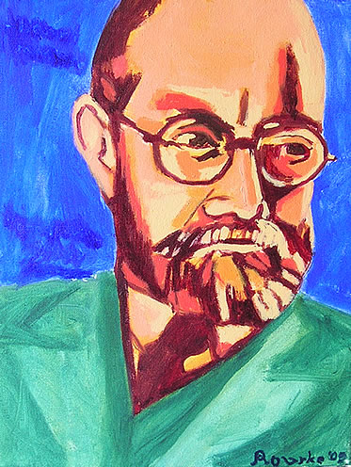
Who were My Influences?
Fauvism Movement- Henri Matisse,

Slide 47
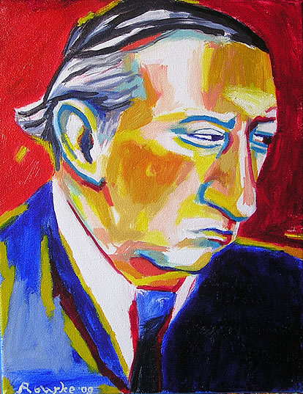
Who were My Influences?
Fauvism Movement- Henri Matisse, Andre Derain and

Slide 48
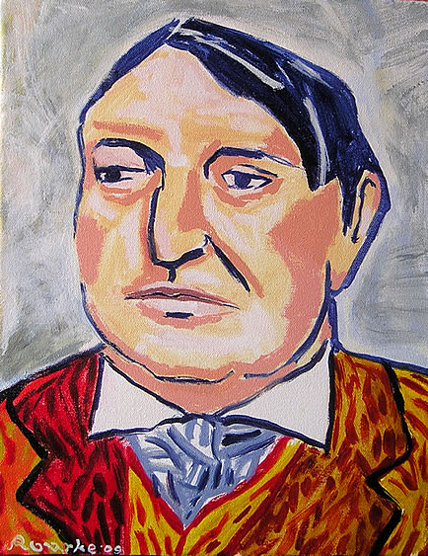
Who were My Influences?
Fauvism Movement- Henri Matisse, Andre Derain and Maurice de Vlaminck.

Slide 49
Who were My Influences?
Fauvism Movement- Henri Matisse, Andre Derain and Maurice de Vlaminck.
Neo-Expressionist Movement-

Slide 50
Who were My Influences?
Fauvism Movement- Henri Matisse, Andre Derain and Maurice de Vlaminck.
Neo-Expressionist Movement- Jean Michel Basquiat (1960-1988),

Slide 51
Who were My Influences?
Fauvism Movement- Henri Matisse, Andre Derain and Maurice de Vlaminck.
Neo-Expressionist Movement- Jean Michel Basquiat (1960-1988), Matt Sesow (1966- )

Slide 52
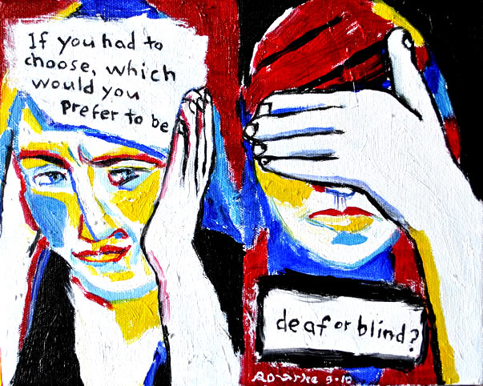
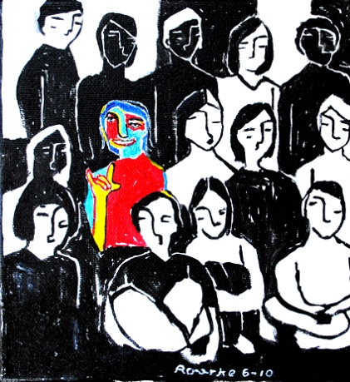
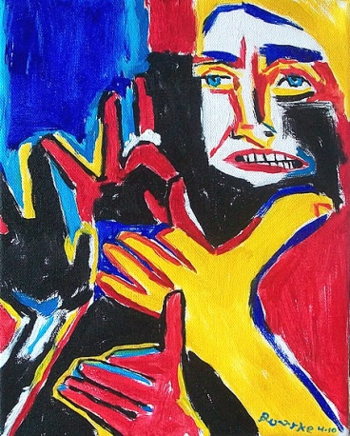
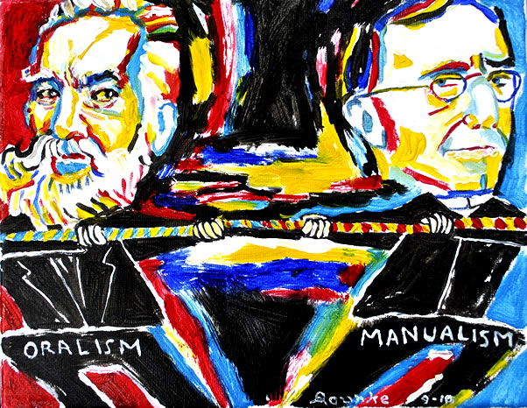
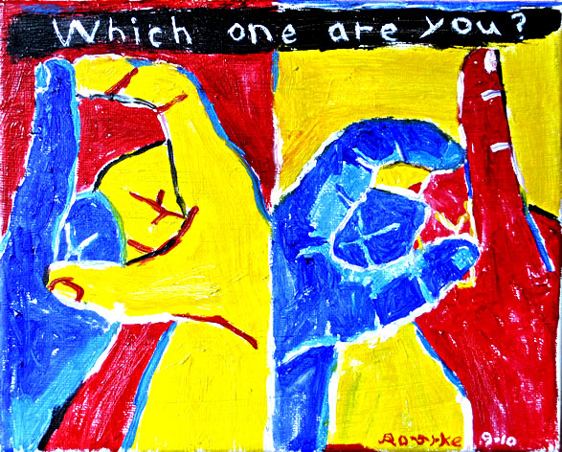
My Art Theme

Slide 53
My Art Theme
Bright and strident colors; primary colors in

Slide 54
My Art Theme
Bright and strident colors; primary colors in red,

Slide 55
My Art Theme
Bright and strident colors; primary colors in red, blue

Slide 56
My Art Theme
Bright and strident colors; primary colors in red, blue and yellow.

Slide 57
My Art Theme
Bright and strident colors; primary colors in red, blue and yellow. Black & white pigments for areas of saturated colors.

Slide 58
My Art Theme
Bright and strident colors; primary colors in red, blue and yellow. Black & white pigments for areas of saturated colors.
Strong brushstrokes.

Slide 59
My Art Theme
Bright and strident colors; primary colors in red, blue and yellow. Black & white pigments for areas of saturated colors.
Strong brushstrokes.
Expressive, emotional and sometimes disturbing art.

Slide 60
My Art Theme
Bright and strident colors; primary colors in red, blue and yellow. Black & white pigments for areas of saturated colors.
Strong brushstrokes.
Expressive, emotional and sometimes disturbing art.
Subject matter: Simplification and abstraction.

Slide 61
My Art Process

Slide 62
My Art Process
I write down ideas and scribble notes and drawings, day and night.

Slide 63
My Art Process
I write down ideas and scribble notes and drawings, day and night.
I make sketches and blow up in a projector to trace on big canvases.

Slide 64
My Art Process
I write down ideas and scribble notes and drawings, day and night.
I make sketches and blow up in a projector to trace on big canvases.
I paint from size 5x7 to 30x40 and hope to paint on much bigger sizes.

Slide 65
My Art Process
I write down ideas and scribble notes and drawings, day and night.
I make sketches and blow up in a projector to trace on big canvases.
I paint from size 5x7 to 30x40 and hope to paint on much bigger sizes.
All paintings are oils.

Slide 66
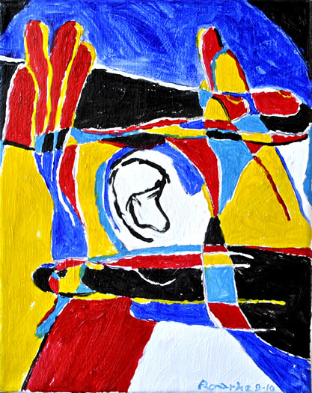
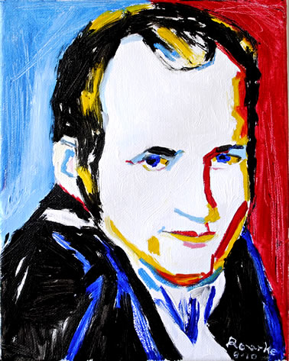
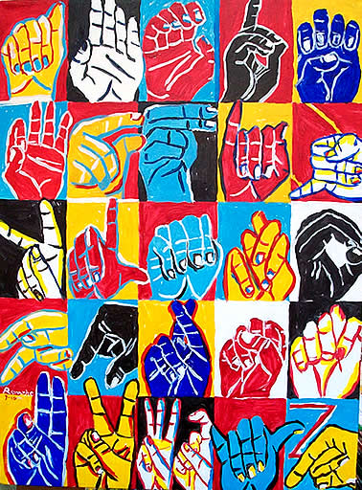
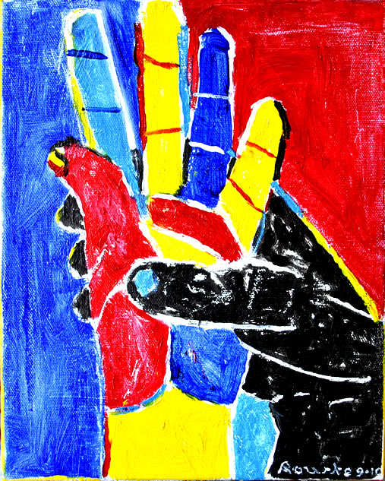
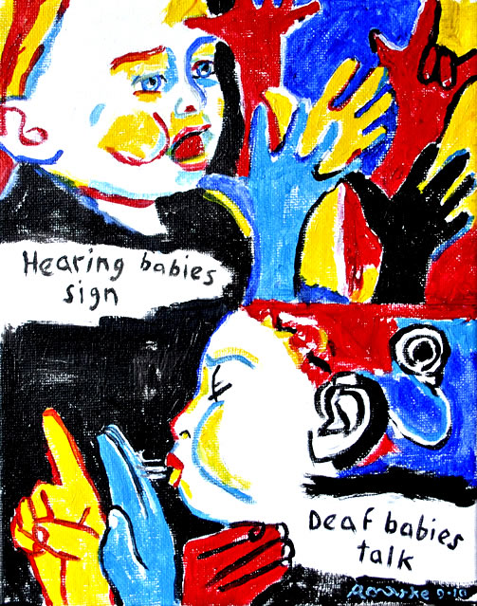
My Art Philosophy

Slide 67
My Art Philosophy
I want to show some appreciation to the Deaf community.

Slide 68
My Art Philosophy
I want to show some appreciation to the Deaf community.
And to express my own Deafhood journey in the paintings.

Slide 69
My Art Philosophy
I want to show some appreciation to the Deaf community.
And to express my own Deafhood journey in the paintings.
As well as exposing Deaf Politics and History in the paintings.

Slide 70
My Art Philosophy
I want to show some appreciation to the Deaf community.
And to express my own Deafhood journey in the paintings.
As well as exposing Deaf Politics and History in the paintings.
And sometimes I express my anger or frustration in the paintings.

Slide 71
Thank you for watching.

