Slide 1
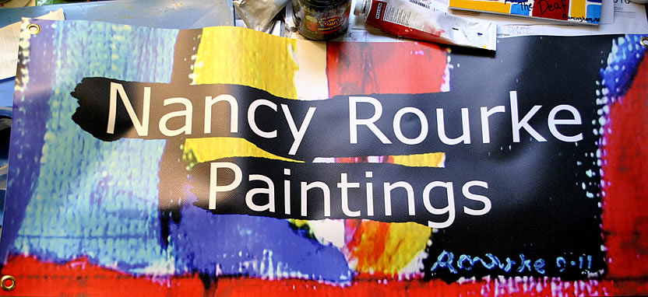
Established in 2010.

Slide 2
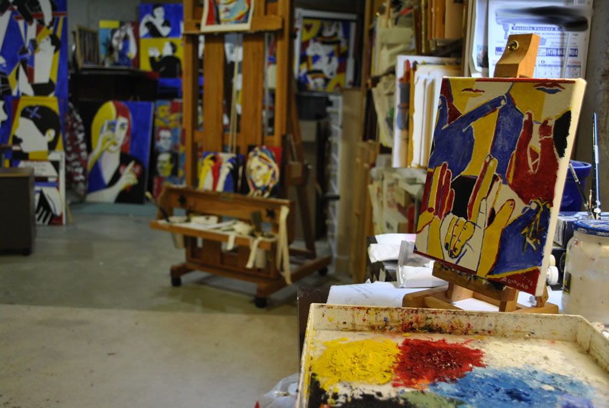
My studio

Slide 3
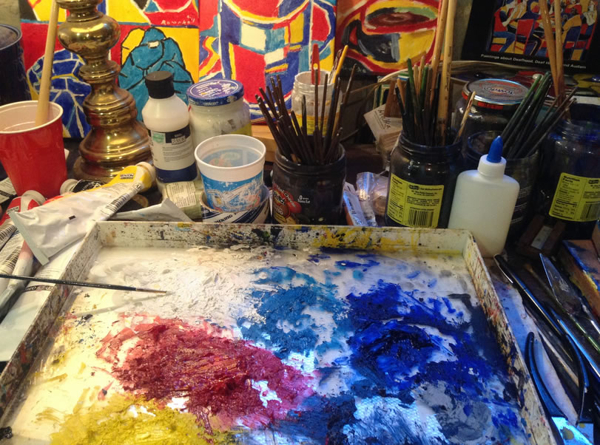
My palette

Slide 4
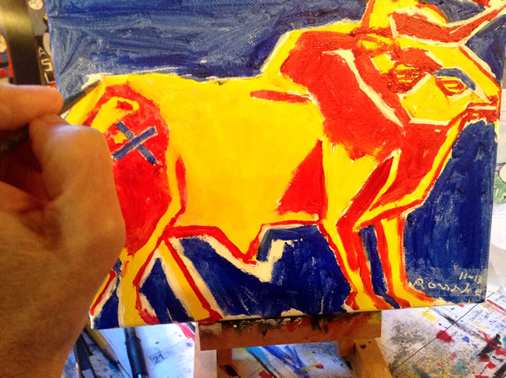

Slide 5
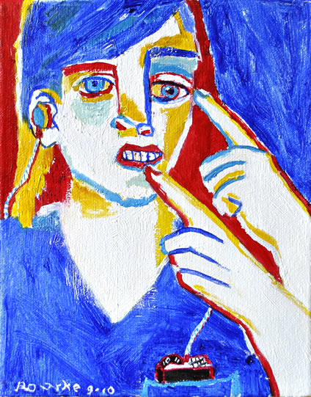
My Art Life

Slide 6
I was born Deaf and I learned to paint when
I was 6 years old.
I went to mainstreamed/oral school.
I went to Rochester Institute of Technology in
Rochester, New York and received 3 degrees in
graphic design and painting.
I was a graphic designer for Xerox, IBM,
20th Century Fox and Microsoft.
I became a full time painter in 2001.

Slide 7
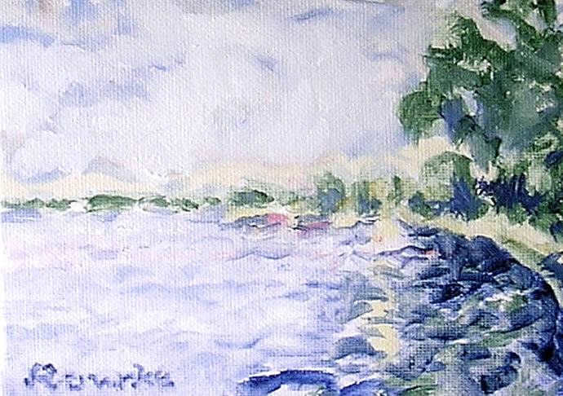
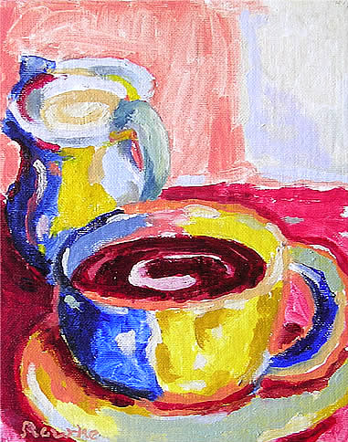
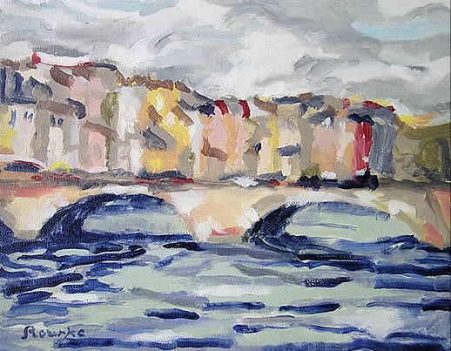
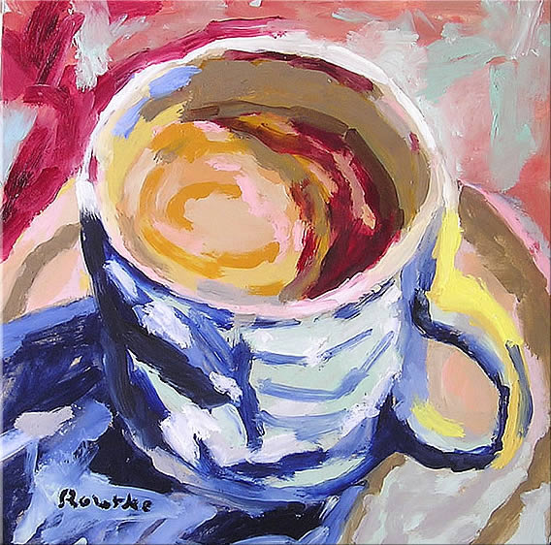
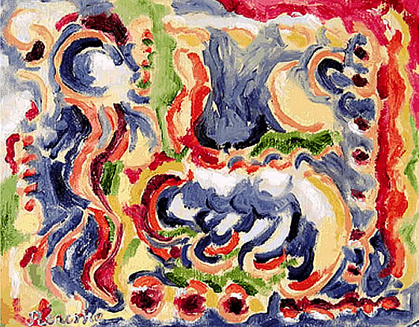
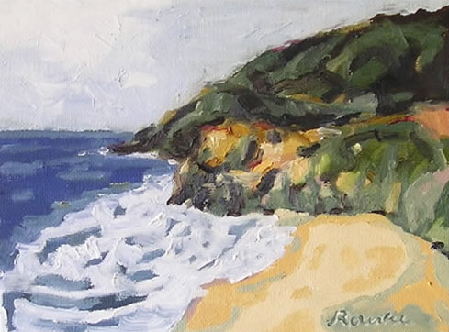
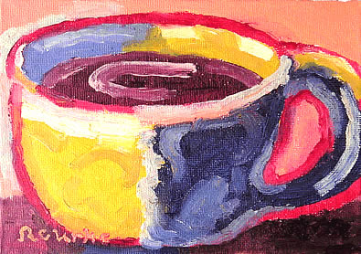
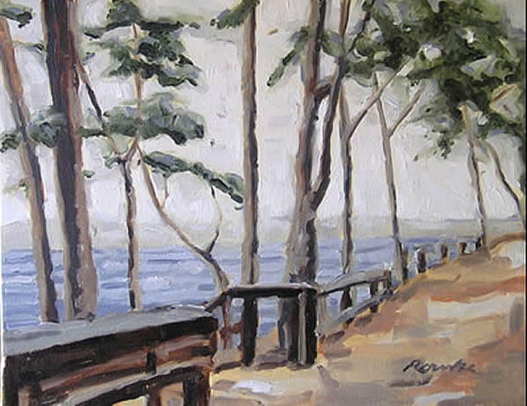
These are my early paintings from 2001-2009.

Slide 8
Then I began painting Deaf art in 2009.

Slide 9
Deaf art, is Deaf View / Image Art.
De’VIA

Slide 10
De’VIA was first established in 1989, with a
manifesto signed by nine Deaf artists.
De’VIA represents Deaf artists and their
perceptions are based on Deaf experiences.
Deaf experiences can include Deaf metaphors and
Deaf perspectives.
The manifesto discuss elements, imagery, and
symbols.
There are three themes.

Slide 11
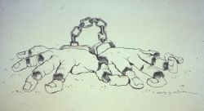
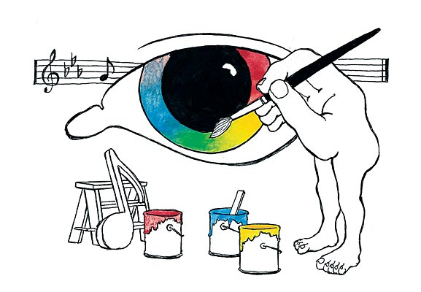
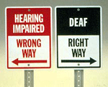
Three Themes
1. Affirmative- ASL, Deafhood, Acceptance
2. Resistance- Audism, Oralism, Identity Confusion
3. Liberation- Empowerment
Motifs- Hands, Eyes, Mouth, puppet, chain, etc.
De’VIA Artists:
Betty G Miller
Chuck Baird
Harry Williams
Ann Silver

Slide 12
Resistance Art
Affirmative Art
Man’s Best Friend by Chuck Bairda
Ba Ba Black Sheep by Betty G Miller

Slide 13
Second Wave of De’VIA 2010-present
-ARTivism (Activist + Artist)
-Visual art about our truths
-Media exploring Deaf history, ASL and Deaf life
-ASL literature
-Social Media
-Surdisme (French)
Themes- Affirmative, Resistance and Liberation

Slide 14
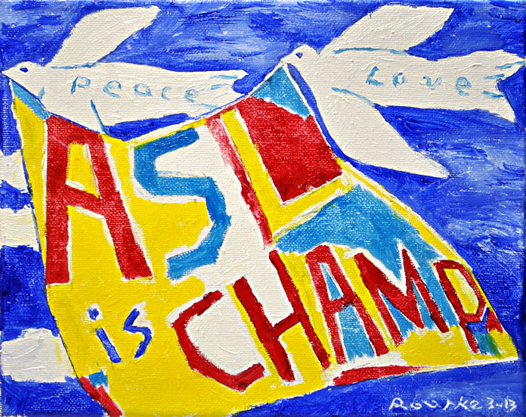
Second Wave of De’VIA Artists
David Call
Ellen Mansfield
Hinda Kasher
Darlene Weir
Nancy Rourke

Slide 15
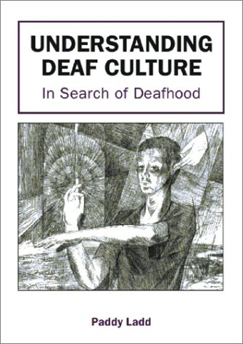
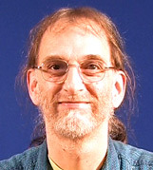
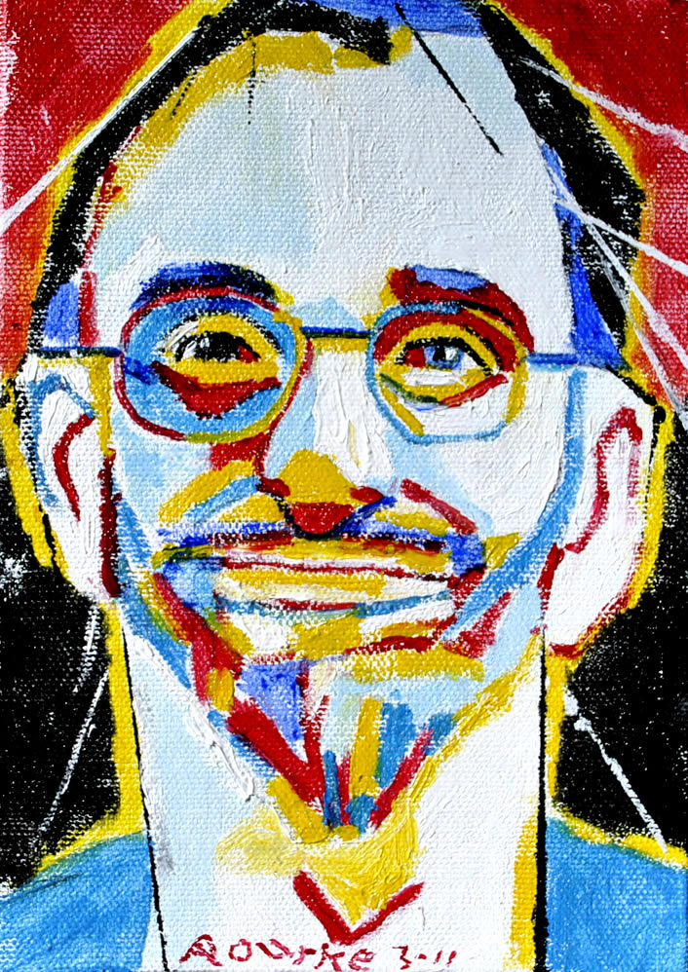
Dr. Paddy Ladd
I was inspired by Paddy Ladd’s book,
and started doing De’VIA paintings in 2010.

Slide 16
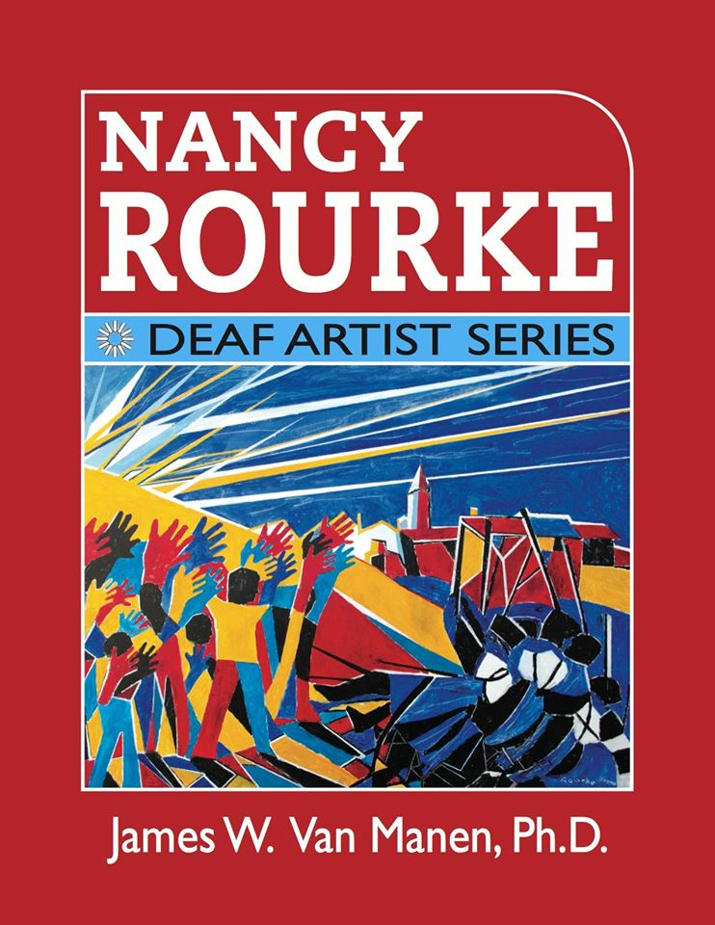
Nancy Rourke: Deaf Artist Series book

Slide 17
The book contains
214 pages
12 chapters
536 images of my paintings
This book is not primarily a biography.
It focuses on my art career to the present, mainly on my personal renaissance as a Deaf artist.

Slide 18
Primary Colors
Each color has its own meanings.
Red- refers to power or taking a stand for justice.
Blue- refers to audism, oralism, and the mask of benevolence.
Turquoise blue- refers to Deafhood journey.
Yellow-refers to light so Deaf people can see, and HOPE.
Monochrome can be both resistance and it gives a reinforcement to provide contrast between the primary colors.

Slide 19
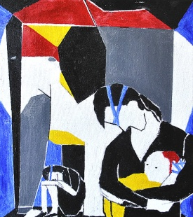
Motifs in Paintings
Painter’s blue tape- tied-down, trapped, crossed-out, mask of benevolence, labeled, ASL prohibited.
Elephant- Alexander Graham Bell and his associates.
Yellow Horse- Deaf people.
Strings- tied down, audism, trapped, colonialism, Deaf person as a puppet.
Ear/Mouth- Audism, oralism, genetic engineering, Eugenics, Alexander Graham Bell.
Black holes- invasion, attacking, Second Wave of Oralism.
Notes:
19

Slide 20
Motifs in My Paintings
Painter’s blue tape- crossed-out.
BEFORE Blue Tape AFTER Blue Tape
EXCEPT
HEAR
Notes:
20

Slide 21
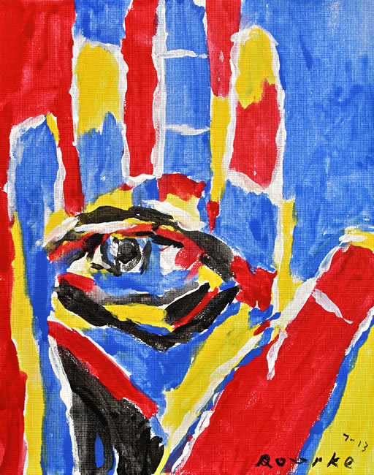
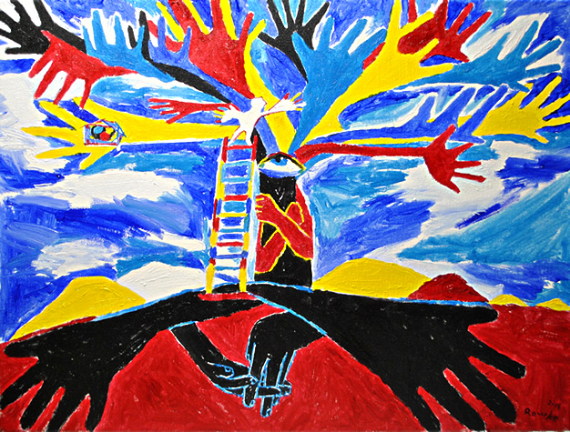
Motifs in My Paintings
Hand- Deaf people, Deaf pride, Deaf culture, sign language.
Eye- Deaf people can see.
Notes:
21

Slide 22
Over 100 Motifs are used in De’VIA art
chain, resistance light bulb, affirmative feather, resistance hand, affirmative mirror, resistance handstand, affirmative lock, resistance flower, affirmative profit, resistance butterfly, affirmative jigsaw puzzle, resistance candle, affirmative AGB, resistance ladder, affirmative blue tape, resistance eyes, affirmative hook, resistance tree, affirmative mask, resistance baby, affirmative nails or screws, resistance hands holding, affirmative
puppet, resistance solitary fist, affirmative octopus, resistance door, affirmative checkerboard, resistance round table, affirmative
Strings, resistance
Sledgehammer, resistance
Violin, affirmative
Elephant, resistance
Birdhouse, affirmative
Arrow, resistance
Nest, affirmative
Button eye, resistance
Plague doctor, resistance
Money bag, resistance
Gloves, resistance
Mother of All Deaf Souls, affirmative
Skull, resistance
Fan, resistance
Mouth, resistance
Stairway, resistance or affirmative
Handshape, affirmative
Speech therapy, resistance
Fish, affirmative
DNA, resistance
Cracks, resistance
Bandaid, resistance
Chair, affirmative
Hamster, resistance
Black bird, resistance
Red mountain, affirmative
Hearing aid/CI, resistance
Ruler, resistance
Drill, resistance
Harlequin/jester, resistance
Cloven Hooves, resistance
Stars, affirmative
Arrow, resistance
Nest, affirmative
Button eye, resistance
Plague doctor, resistance
Money bag, resistance
Gloves, resistance
Mother of All Deaf Souls, affirmative
Skull, resistance
Fan, resistance
Mouth, resistance
Stairway, resistance or affirmative
Handshape, affirmative
Speech therapy, resistance
Fish, affirmative
DNA, resistance
Cracks, resistance
Bandaid, resistance
Chair, affirmative
Hamster, resistance
Black bird, resistance
Red mountain, affirmative
Hearing aid/CI, resistance
Ruler, resistance
Fish, affirmative
DNA, resistance
Cracks, resistance
Bandaid, resistance
Chair, affirmative
Hamster, resistance
Black bird, resistance
Red mountain, affirmative
Hearing aid/CI, resistance
Ruler, resistance
OVER 100 MOTIFS….

Slide 23
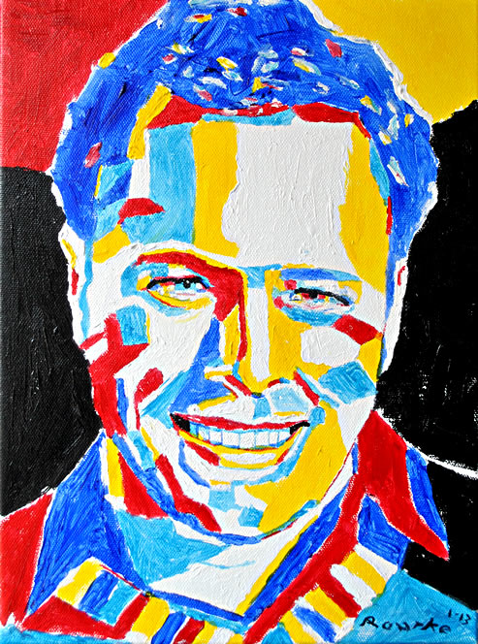
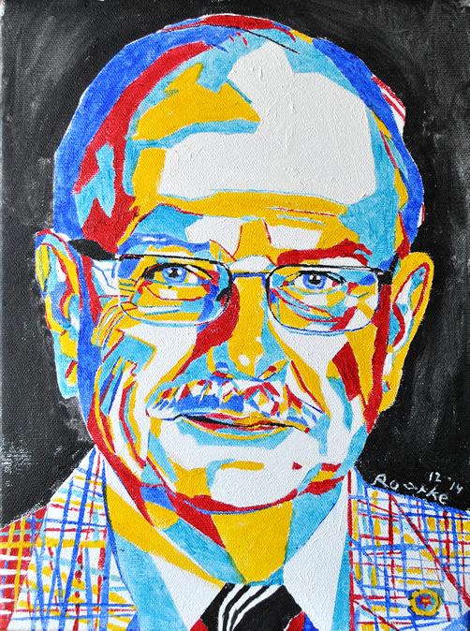
My Trademark
Red/Blue Eyebrows
Notes:
23

Slide 24
Portraits

Slide 25
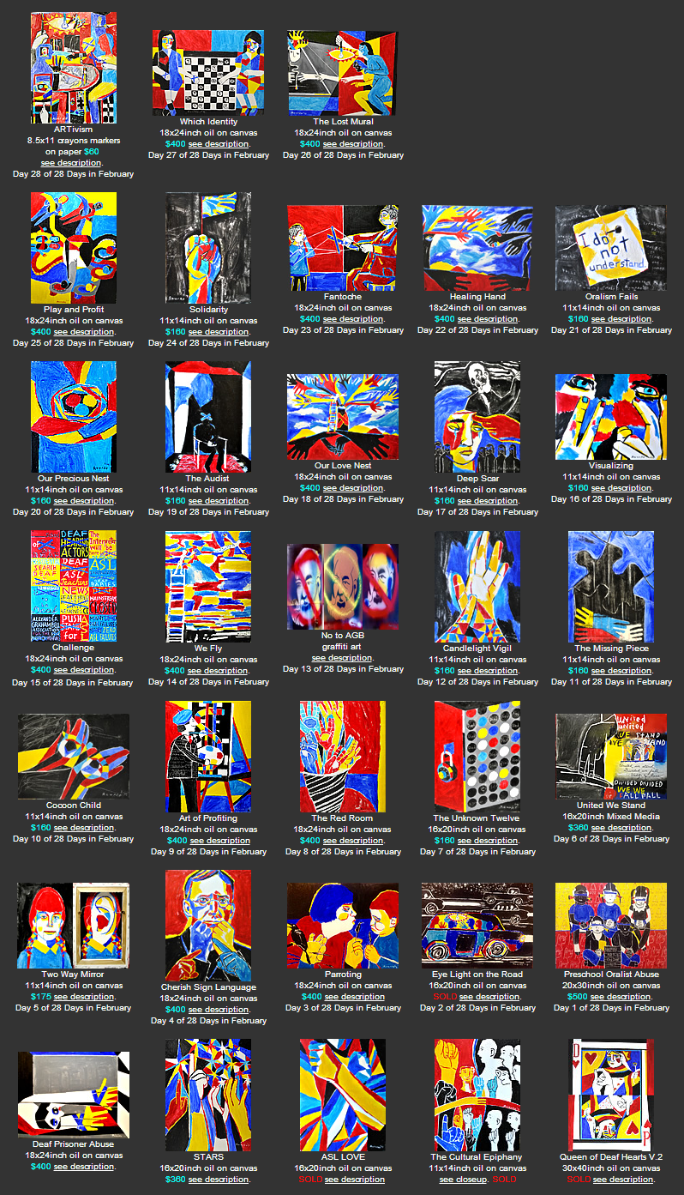
28 Days in February Challenge Project
28 Days in February Challenge Theme: Solidarity/ARTivism Motifs in resistance and affirmative Day 1 chain, resistance 2 light bulb, affirmative 3 feather, resistance 4 hand, affirmative 5 mirror, resistance 6 handstand, affirmative 7 lock, resistance 8 flower, affirmative 9 profit, resistance 10 butterfly, affirmative 11 jigsaw puzzle, resistance 12 candle, affirmative 13 AGB, resistance 14 ladder, affirmative 15 blue tape, resistance 16 eyes, affirmative 17 hook, resistance 18 tree, affirmative 19 mask, resistance 20 baby, affirmative 21 nails or screws, resistance 22 hands holding, affirmative
677 artworks
55 participants
5 from Europe
23 puppet, resistance 24 solitary fist, affirmative 25 octopus, resistance 26 door, affirmative 27 checkerboard, resistance 28 round table, affirmative Rules 1) Artwork must be completed each day. 2) you can use any medium. Any size of artwork. 3) Do your own creativity. 4) **Must be Deaf Experience.** 5) Post your finished artwork, with title, your name, medium, size, and description on De'VIA Central FB page.

Slide 26
3 Things I see De’VIA in Art
1.De’VIA work is based on Deaf experience and express it in art.
2.Motifs are used in art.
3.Three themes are used in De’VIA artwork:
1 Affirmative (happy, acceptance)
2 Resistance (political, angry)
3 Liberation (both of the two themes)
Notes:
26

Slide 27
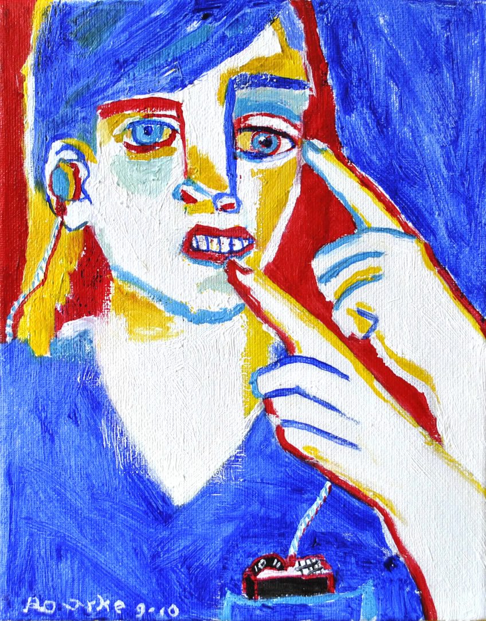
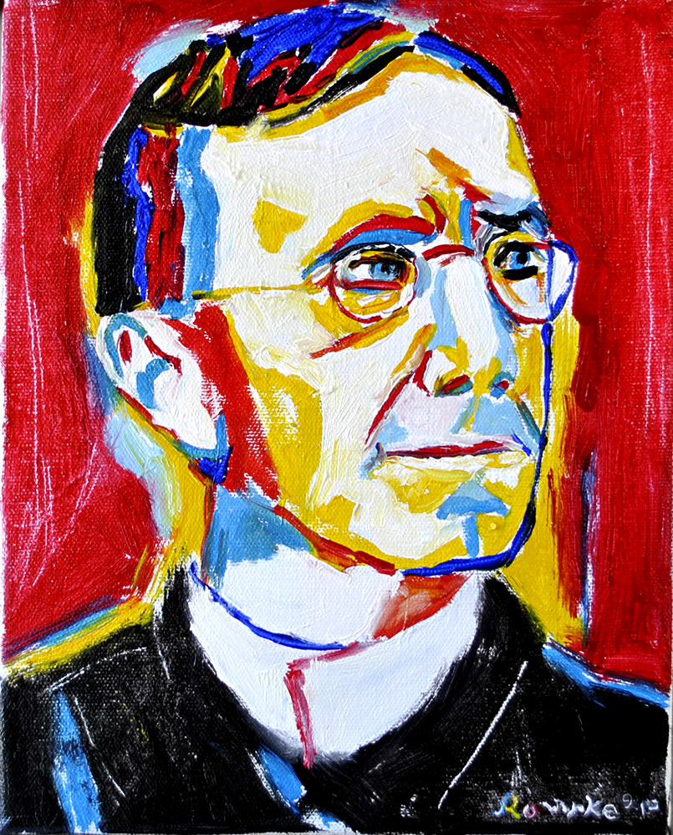
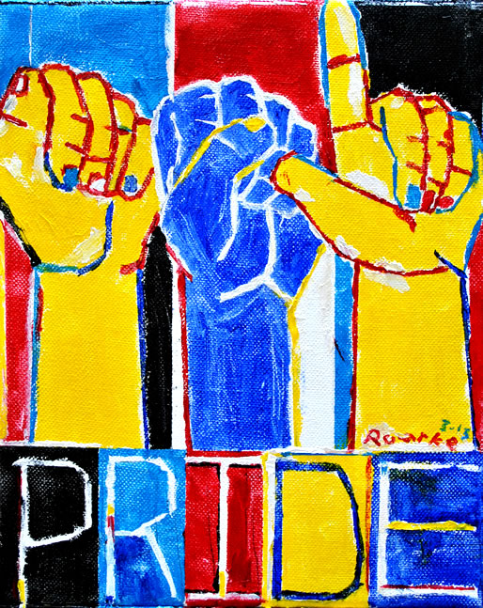
Affirmative Art (acceptance, happy art)
Acceptance Deaf History ASL
This is who I am. This is George Veditz. This is our visual language.

Slide 28
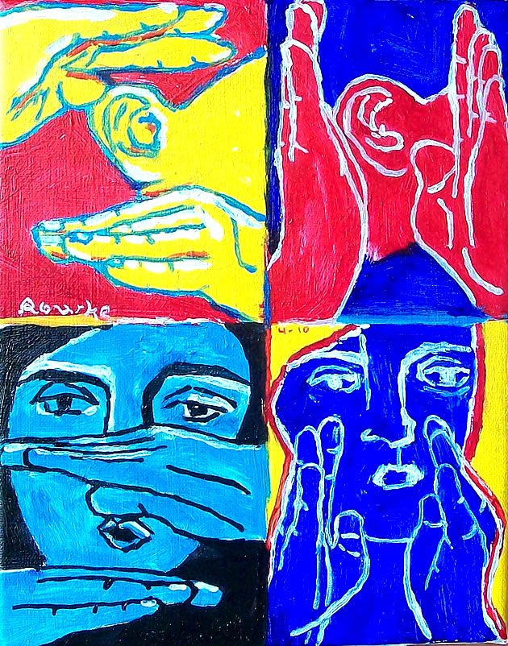
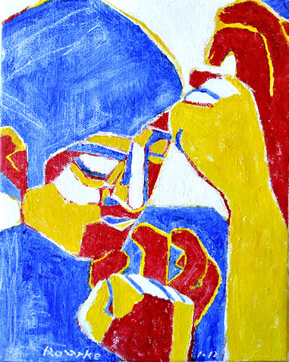
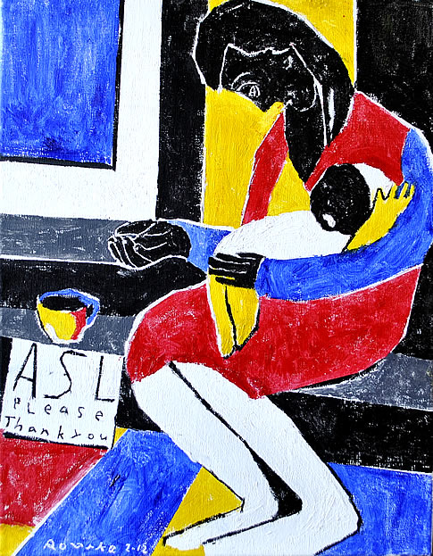
Resistance Art (political, angry art)
Audism Colonialism Linguistic controversy

Slide 29
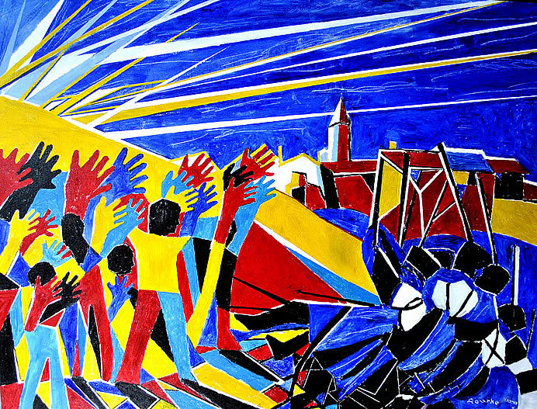
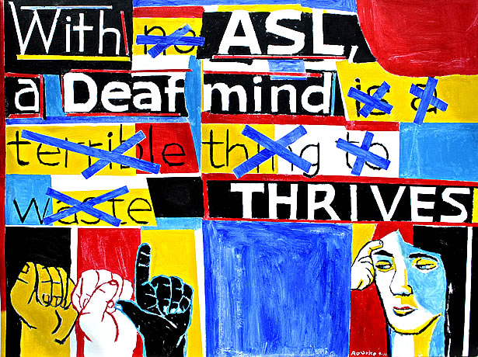
Liberation Art (affirmative & resistance combined)
We Came, We Saw, We Conquered ASL Thrives

Slide 30
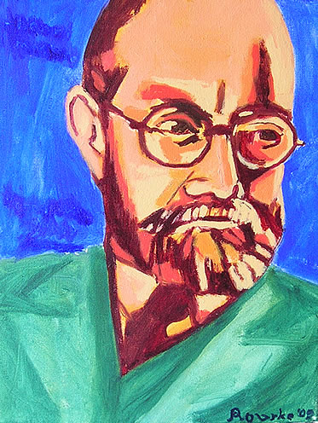
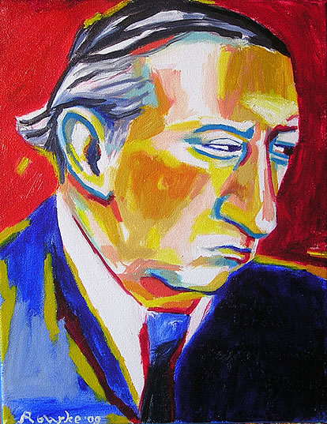
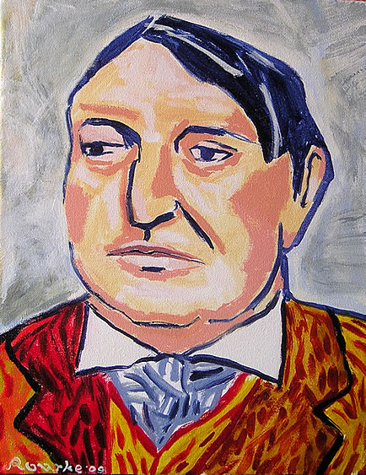
Who were My Influences?
Fauvism Movement- Henri Matisse, Andre Derain and Maurice de Vlaminck.
Notes:
30

Slide 31
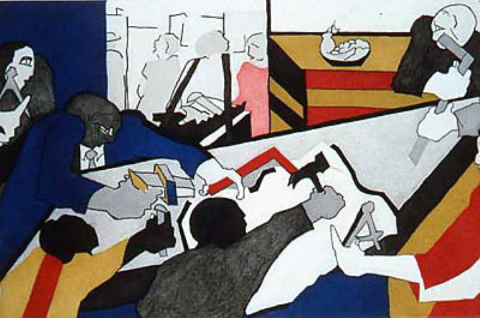
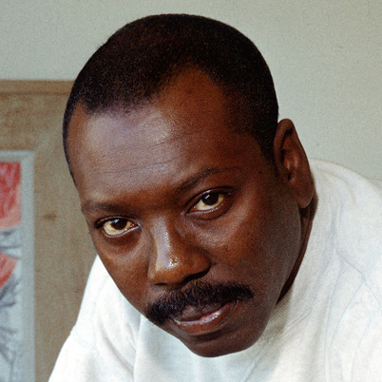
Who were My Influences?
2. Harlem Renaissance Movement- Jacob Lawrence
Notes:
31

Slide 32
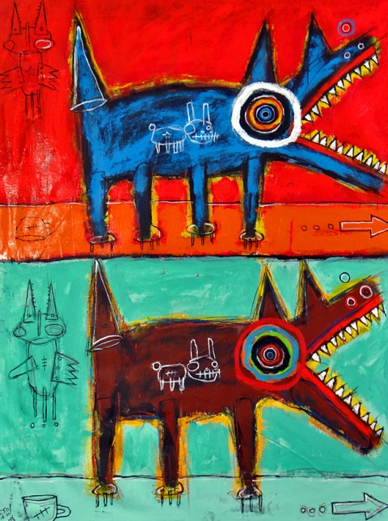
Who were My Influences?
3. Neo-Expressionist Movement-
Jean Michel Basquiat Matt Sesow
Notes:
32

Slide 33
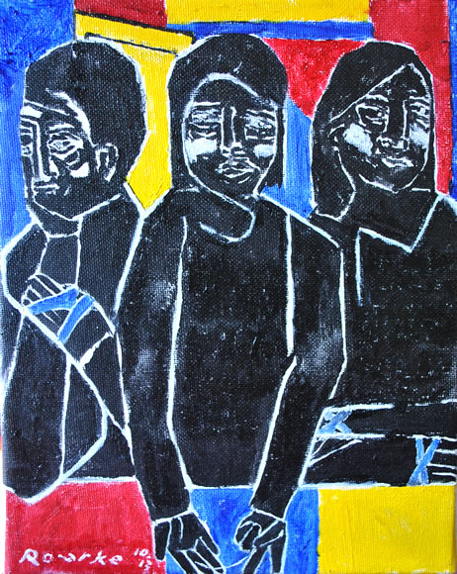
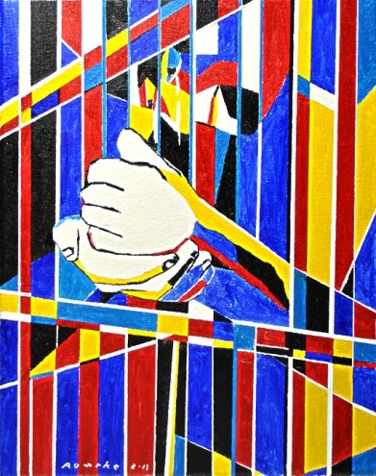
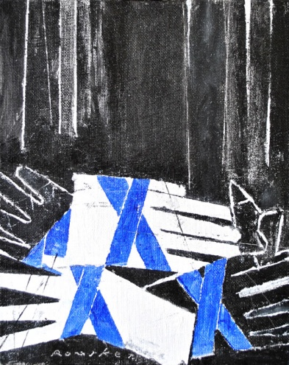
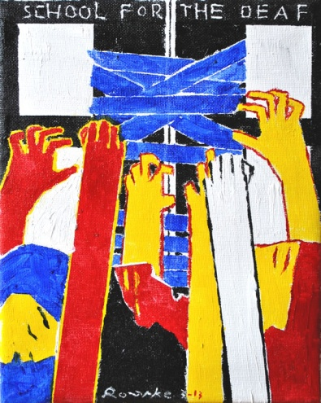
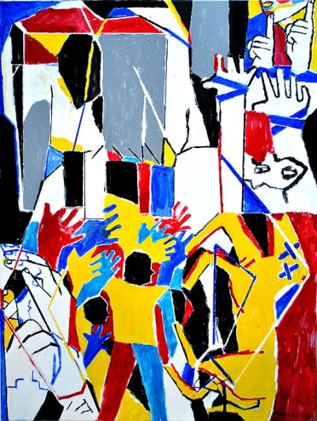
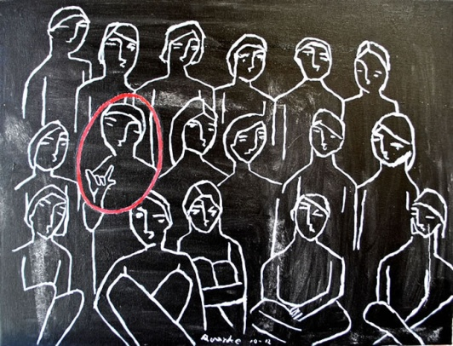
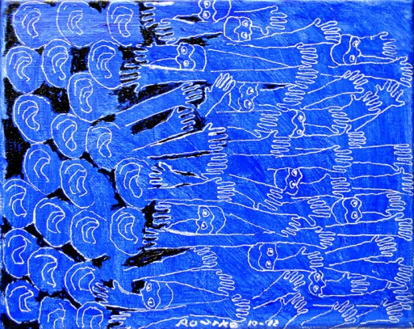
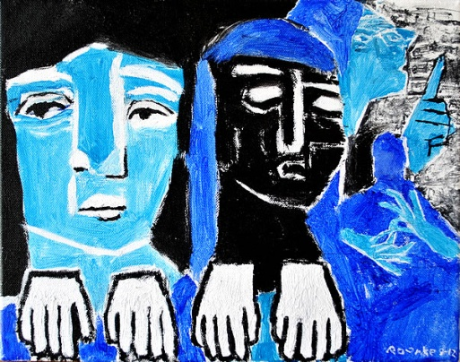
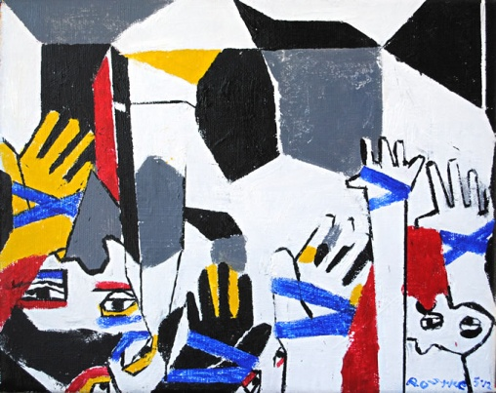
Resistance Art on Audism

Slide 34
Deaf Beaten

Slide 35
Affirmative Art – The Deaf Mind
This painting is about how a Deaf person thinks, perceives, visualizes, sees, understands with a Deaf mind, perhaps in a complex way. The signs represent 'mind', 'penetrate', 'visual', and 'understand.'
The person in the painting is in deep thinking.
This painting is on the book cover, "Introduction to American Deaf Culture", Oxford University Press, Author Thomas K.Holcomb, First Edition, October 2012.

Slide 36
Affirmative Art on Deaf Culture

Slide 37
Affirmative Art on Sign Language

Slide 38
Affirmative Art on Deaf Culture

Slide 39
Liberation Art on Empowerment
I did the painting as in celebrating our conquer over the 130years infamous Milan 1880 Congress. The International Congress on Deaf Education (ICED) was held in Vancouver, Canada in July 2010 and made an announcement, a regret and rejection of the eight resolutions that were passed at the Milan 1880 Congress. It took 130 years to see this has come to an end, especially for the Deaf people in the past had suffered under the oralist regime, did not live to see this. Now, this is a new era.
In the painting, the hands waving have overcame the 'oralism' soldiers falling and defeated. At the early dawn, the sun rises to brighten the day as the new era has arrived.
We Came, We Saw, We Conquered
http://www.nancyrourke.com/wecame.htm

Slide 40
Hidden Message
http://www.nancyrourke.com/wecame.htm

Slide 41
Affirmative Art on Deaf History

Slide 42
Message Paintings inspired by Jean Michel Basquait

Slide 43
Liberation Art – ASL THRIVES
http://www.nancyrourke.com/aslthrives.htm

Slide 44
Seven paintings shown on ABC Family Channel ‘Switched at Birth’ 2013

Slide 45
with ART and being an ACTivist, De’VIA artists become ARTivists.

Slide 46
Four De’VIA artists and I were invited
to showcase our paintings at the International
Deaf Art Exhibition in Saint Petersburg, Russia.

Slide 47
Video clippings of My De’VIA Work
http://www.youtube.com/watch?v=6RA8SN4Yhns
http://www.youtube.com/watch?v=9RmaBaQHgiw
http://www.youtube.com/watch?v=vYLWtyAyMg0
http://www.youtube.com/watch?v=uhFnnP-LsZA
http://www.youtube.com/watch?v=MlLrRF_lz9Y
www.nancyrourke.com
Follow Nancy Rourke Expressionist Paintings Facebook
Twitter-https://twitter.com/nancyrourke

Slide 48
Thank you
for watching.

