Slide 1
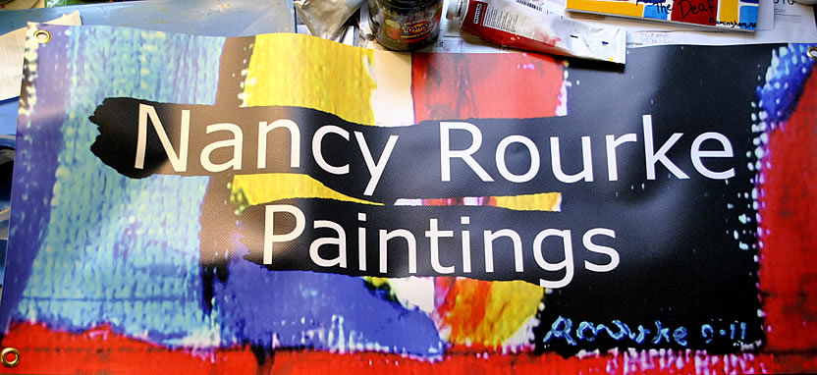
Model Secondary School for the Deaf May 5, 2015

Slide 2
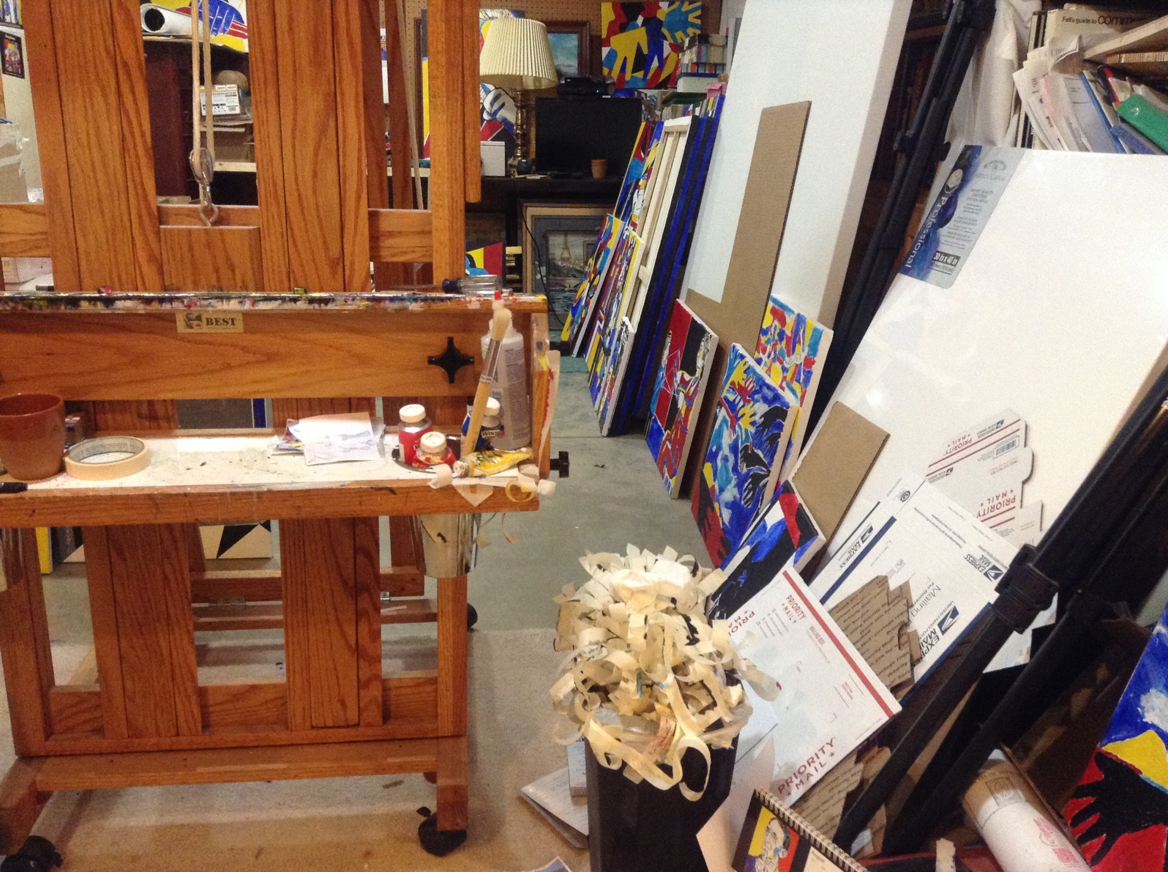
My studio

Slide 3
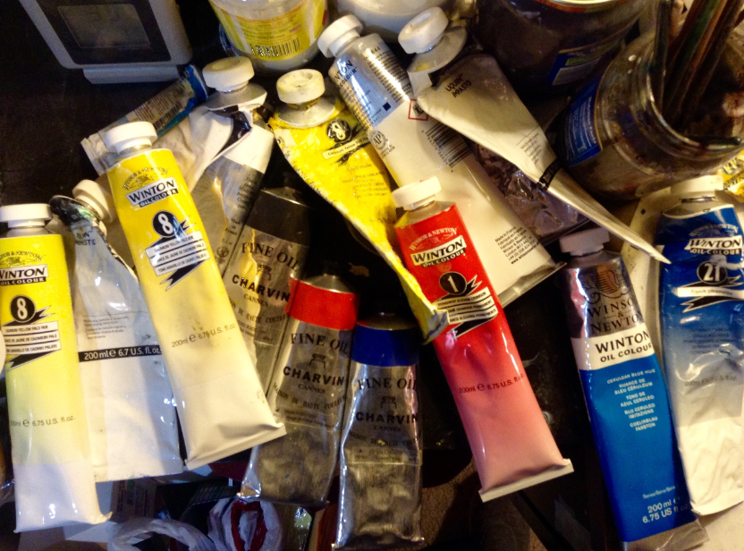

Slide 4
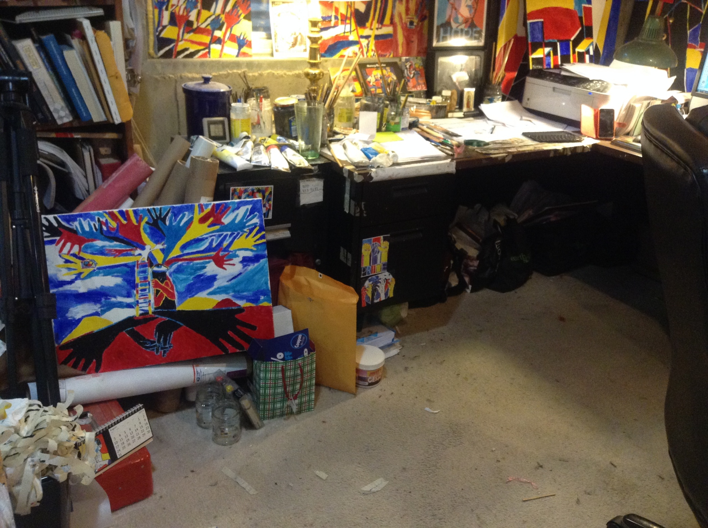

Slide 5
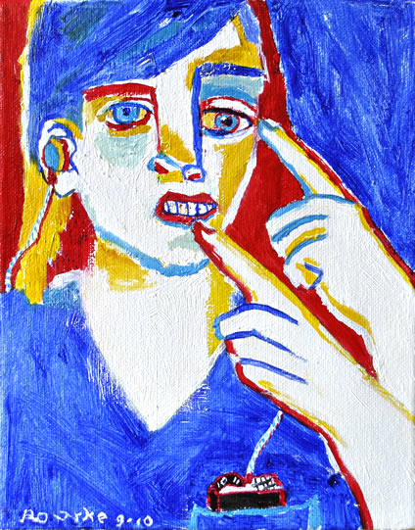
My Art Life

Slide 6
I was born Deaf and I learned to paint when
I was 6 years old.
I went to mainstreamed/oral school.
I went to Rochester Institute of Technology in
Rochester, New York and received 3 degrees in
graphic design and painting.
I was a graphic designer for Xerox, IBM,
20th Century Fox and Microsoft.
I became a full time painter in 2001.

Slide 7
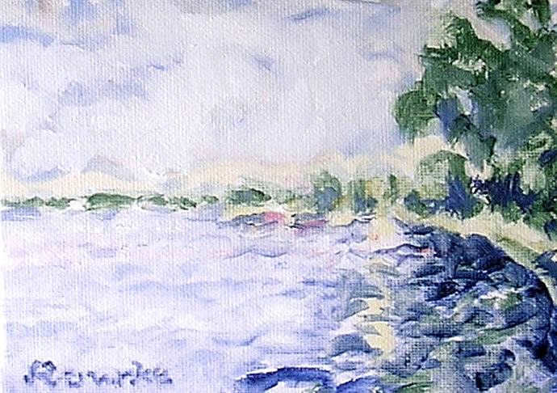
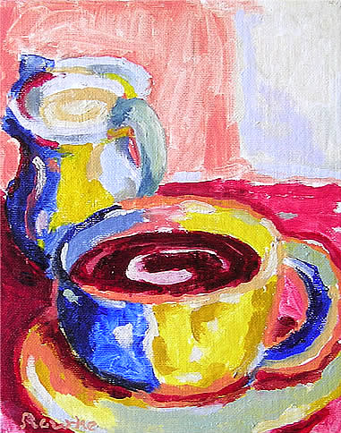
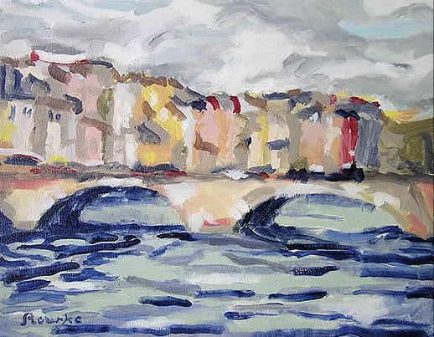
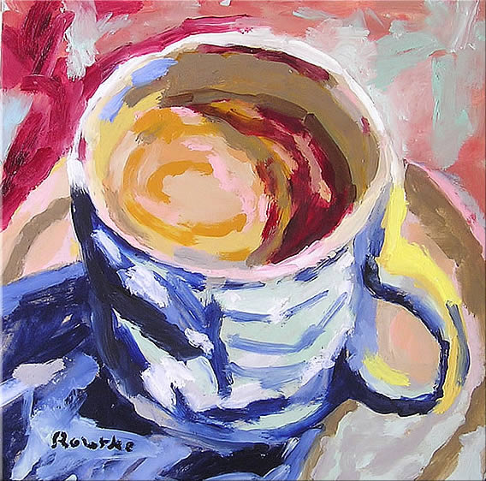
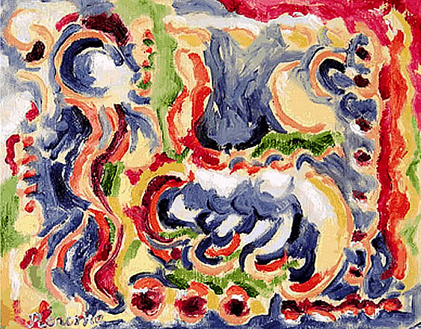
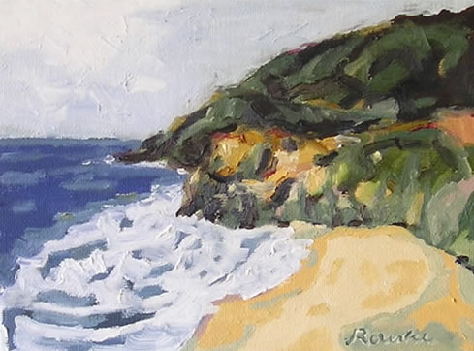
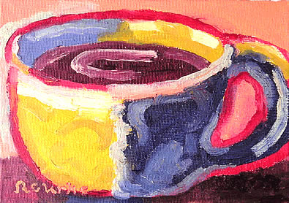
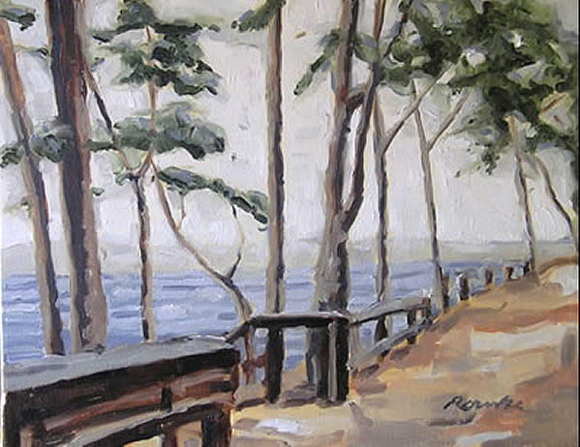
These are my early paintings from 2001-2009.

Slide 8
Then I began Deaf art in 2009.

Slide 9
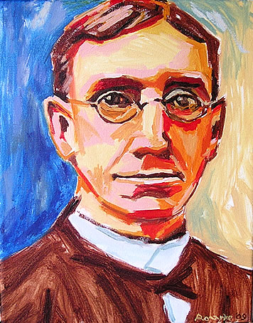
2009
First painting of George Veditz.

Slide 10
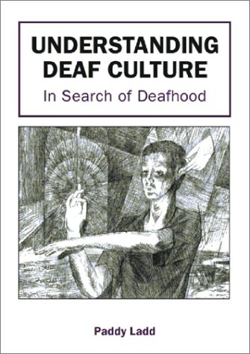
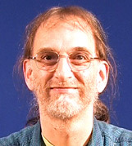
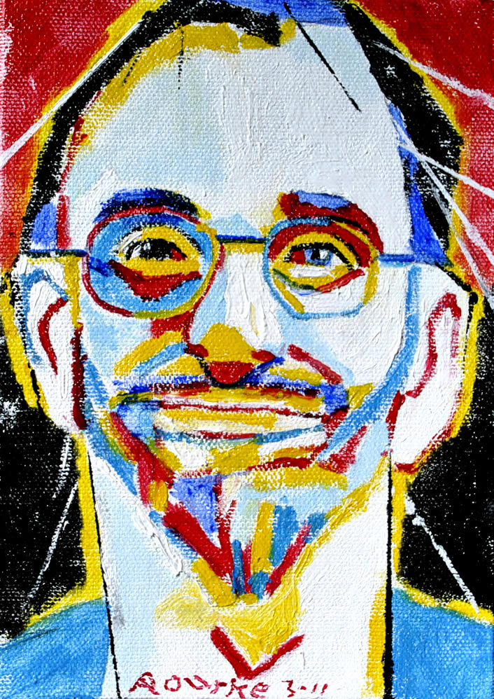
2010
I was inspired by Paddy Ladd’s book,
and started doing De’VIA paintings in 2010.

Slide 11
I learned that Deaf Art is,
Deaf View / Image Art. De’VIA
2010

Slide 12
De’VIA was first established in 1989, with a
manifesto signed by nine Deaf artists.
History of De’VIA

Slide 13
1989 De’VIA Mural-
History of De’VIA

Slide 14
De’VIA 1989-
1. is based on Deaf experiences.
2. includes Deaf metaphors and Deaf perspectives.
3. discusses elements, imagery, and MOTIFS.
4. shows three themes.

Slide 15
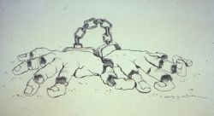
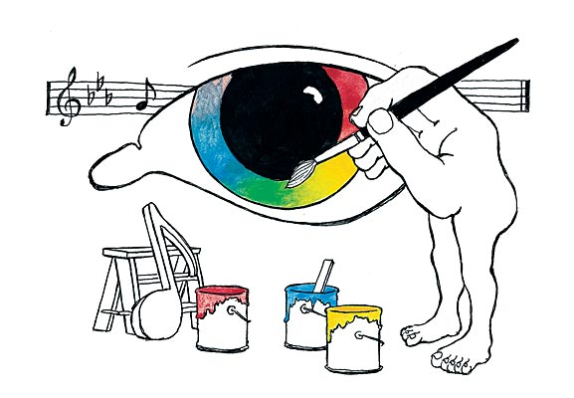
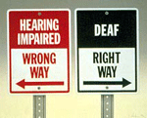
Three Themes
1. Affirmative- ASL, Deaf Pride, Deaf Culture
2. Resistance- Audism, Truth to be Told.
3. Liberation- both Affirmative and Resistance
Motifs- Hands, Eyes, Mouth, etc.
De’VIA Artists:
Betty G Miller
Chuck Baird
Harry Williams
Ann Silver

Slide 16
Today’s De’VIA 2010-Present
Second Wave of De’VIA 2010-present
-ARTivism (Activist + Artist)
-Visual art to educate the world about our Deaf Culture.
-To explose more on Deaf history, ASL and Deaf life
-ASL literature
-Social Media
Themes- Affirmative, Resistance and Liberation

Slide 17
Today’s De’VIA 2010-Present
2013 De’VIA Mural ARTivism

Slide 18
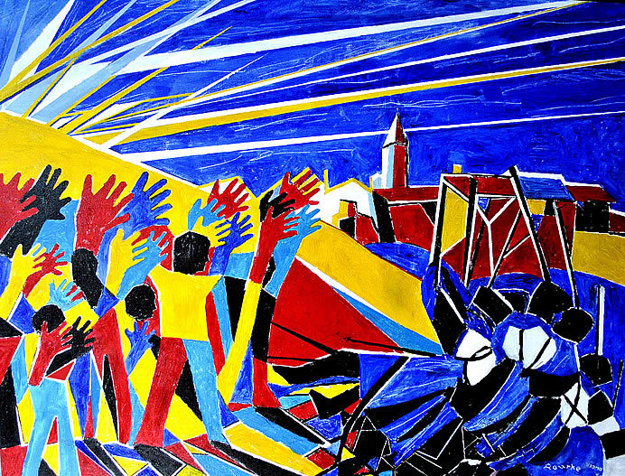
Second Wave of De’VIA Artists
David Call
Ellen Mansfield
Hinda Kasher
Nancy Rourke
and many
more.

Slide 19
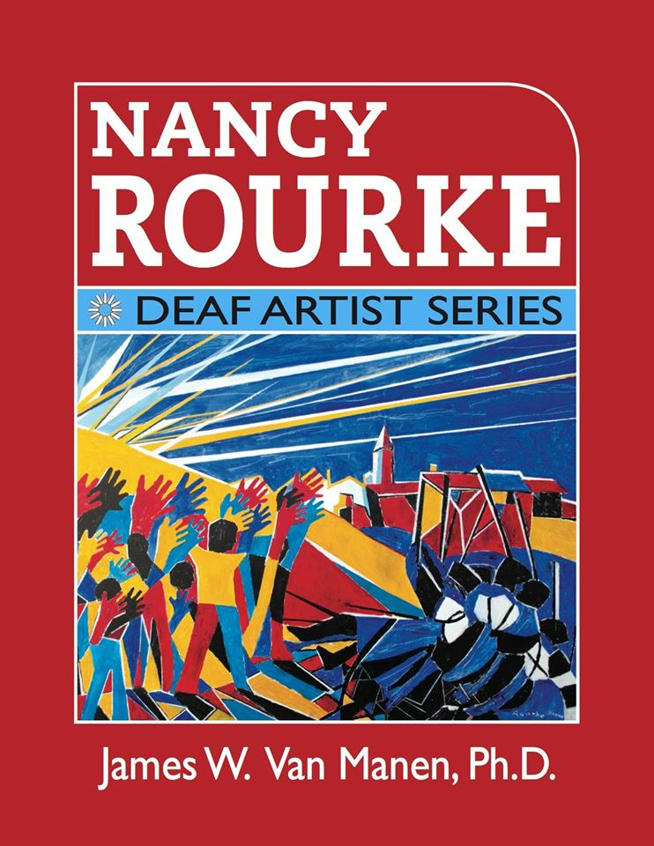
Nancy Rourke: Deaf Artist Series book

Slide 20
The book contains
214 pages
12 chapters
536 images of my paintings
This book is not primarily a biography.
It focuses on my art career to the present, mainly on my personal renaissance as a Deaf artist.

Slide 21
Primary Colors
Each color has its own meanings.
Red- refers to power or taking a stand for justice.
Blue- refers to audism, oralism, and the mask of benevolence.
Turquoise blue- refers to Deafhood journey.
Yellow-refers to light so Deaf people can see, and HOPE.
Monochrome can be both resistance and it gives a reinforcement to provide contrast between the primary colors.

Slide 22
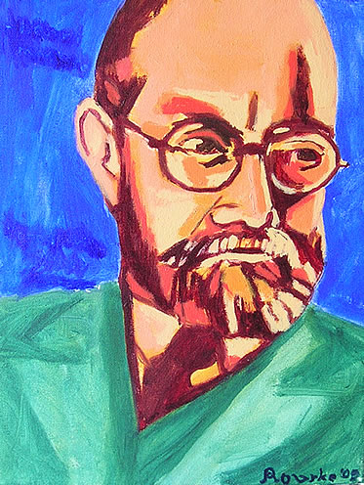
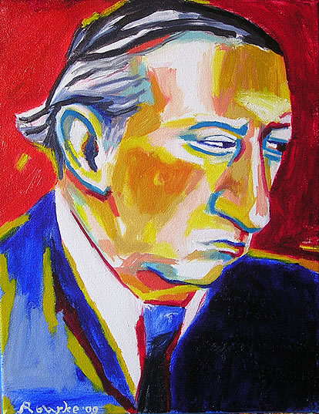
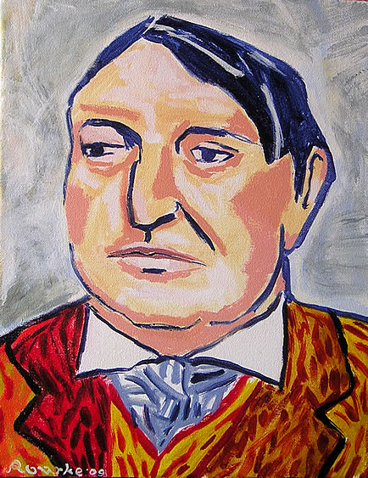
Who were My Influences?
Fauvism Movement- Henri Matisse, Andre Derain and Maurice de Vlaminck.
Notes:
22

Slide 23
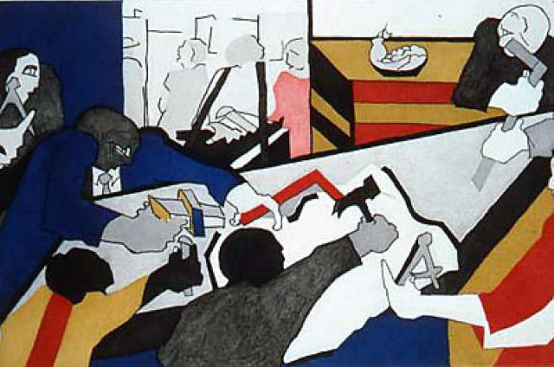
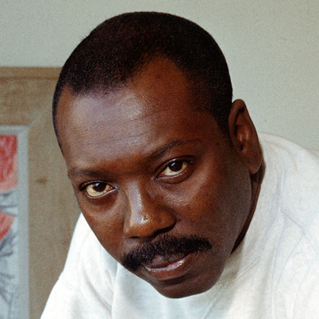
Who were My Influences?
2. Harlem Renaissance Movement- Jacob Lawrence
Notes:
23

Slide 24
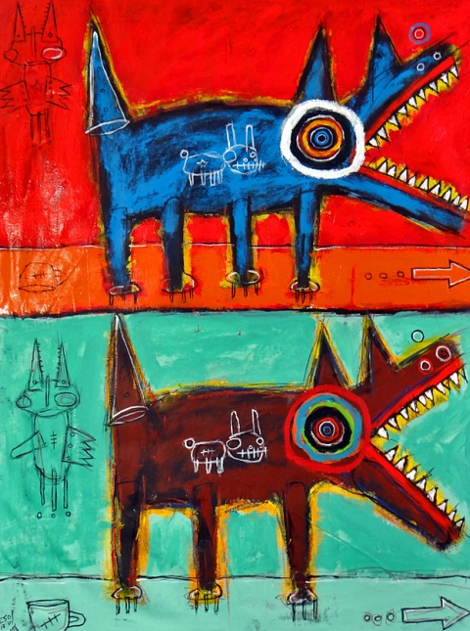
Who were My Influences?
3. Neo-Expressionist Movement-
Jean Michel Basquiat Matt Sesow
Notes:
24

Slide 25
Motifs in My Paintings
Painter’s blue tape- crossed-out.
BEFORE Blue Tape AFTER Blue Tape
EXCEPT
HEAR
Notes:
25

Slide 26
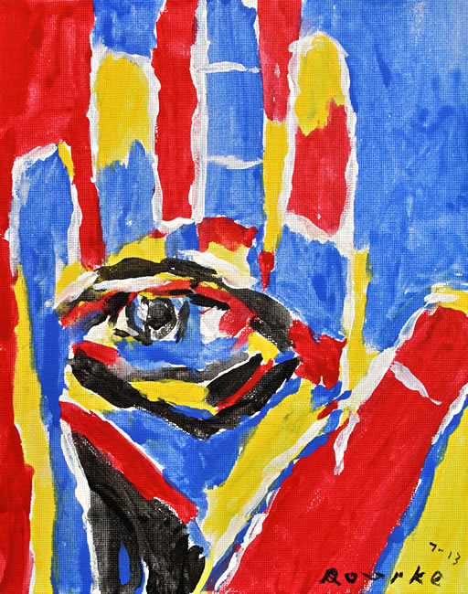
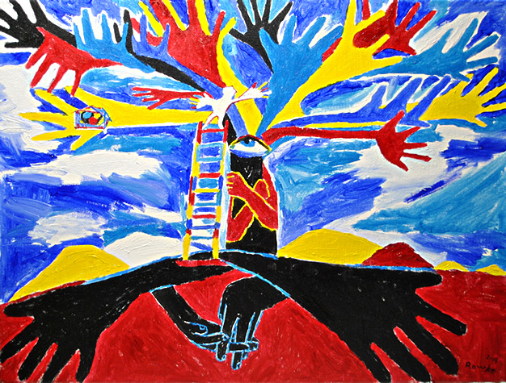
Motifs in My Paintings
Hand- Deaf people, Deaf pride, Deaf culture, sign language.
Eye- Deaf people can see.
Notes:
26

Slide 27
Over 100 Motifs are used in De’VIA art
chain, resistance light bulb, affirmative feather, resistance hand, affirmative mirror, resistance handstand, affirmative lock, resistance flower, affirmative profit, resistance butterfly, affirmative jigsaw puzzle, resistance candle, affirmative AGB, resistance ladder, affirmative blue tape, resistance eyes, affirmative hook, resistance tree, affirmative mask, resistance baby, affirmative nails or screws, resistance hands holding, affirmative
puppet, resistance solitary fist, affirmative octopus, resistance door, affirmative checkerboard, resistance round table, affirmative
Strings, resistance
Sledgehammer, resistance
Violin, affirmative
Elephant, resistance
Birdhouse, affirmative
Arrow, resistance
Nest, affirmative
Button eye, resistance
Plague doctor, resistance
Money bag, resistance
Gloves, resistance
Mother of All Deaf Souls, affirmative
Skull, resistance
Fan, resistance
Mouth, resistance
Stairway, resistance or affirmative
Handshape, affirmative
Speech therapy, resistance
Fish, affirmative
DNA, resistance
Cracks, resistance
Bandaid, resistance
Chair, affirmative
Hamster, resistance
Black bird, resistance
Red mountain, affirmative
Hearing aid/CI, resistance
Ruler, resistance
Drill, resistance
Harlequin/jester, resistance
Cloven Hooves, resistance
Stars, affirmative
Arrow, resistance
Nest, affirmative
Button eye, resistance
Plague doctor, resistance
Money bag, resistance
Gloves, resistance
Mother of All Deaf Souls, affirmative
Skull, resistance
Fan, resistance
Mouth, resistance
Stairway, resistance or affirmative
Handshape, affirmative
Speech therapy, resistance
Fish, affirmative
DNA, resistance
Cracks, resistance
Bandaid, resistance
Chair, affirmative
Hamster, resistance
Black bird, resistance
Red mountain, affirmative
Hearing aid/CI, resistance
Ruler, resistance
Fish, affirmative
DNA, resistance
Cracks, resistance
Bandaid, resistance
Chair, affirmative
Hamster, resistance
Black bird, resistance
Red mountain, affirmative
Hearing aid/CI, resistance
Ruler, resistance
OVER 100 MOTIFS….

Slide 28
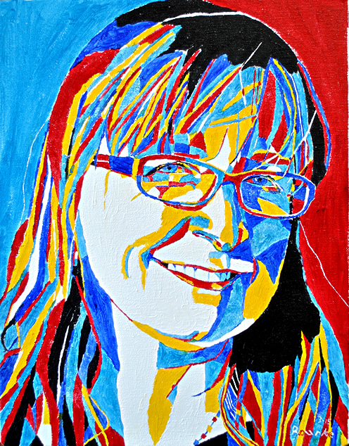
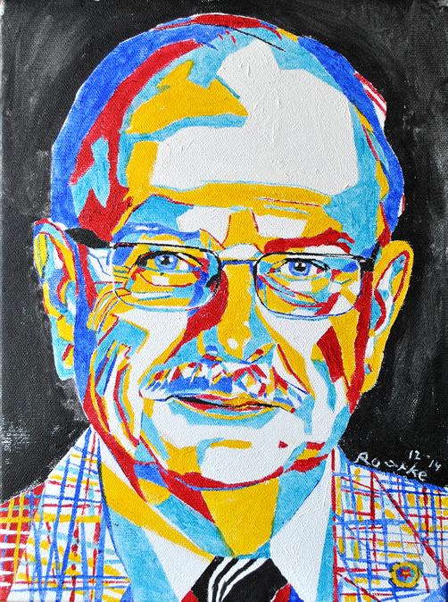
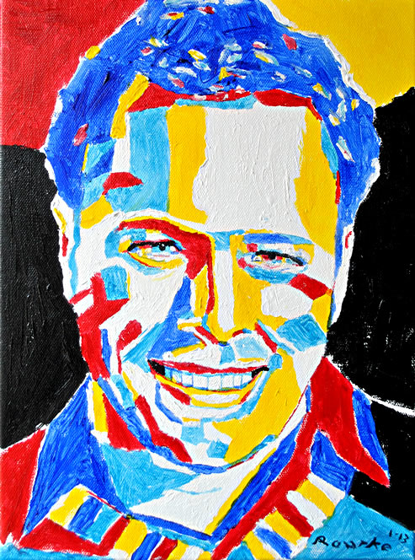
My Trademark
RED, YELLOW and BLUE
Red/Blue Eyebrows
Notes:
28

Slide 29
Portraits

Slide 30
3 Things I see De’VIA in Art
1. Deaf experience. Express that in art.
2.Motifs are used in art.
3.Three themes are used in De’VIA artwork:
1 Affirmative Deaf Pride, Deaf Culture
2 Resistance Truth to be Told.
3 Liberation (both of the two themes)
Notes:
30

Slide 31
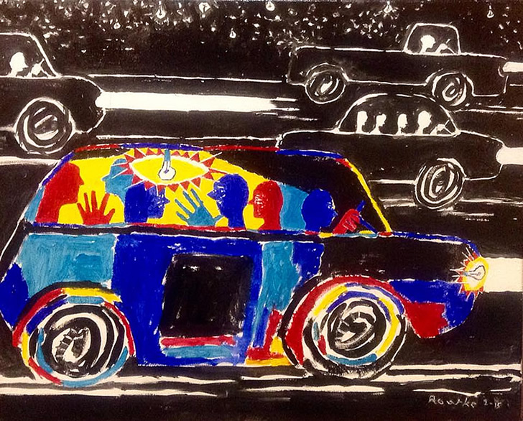
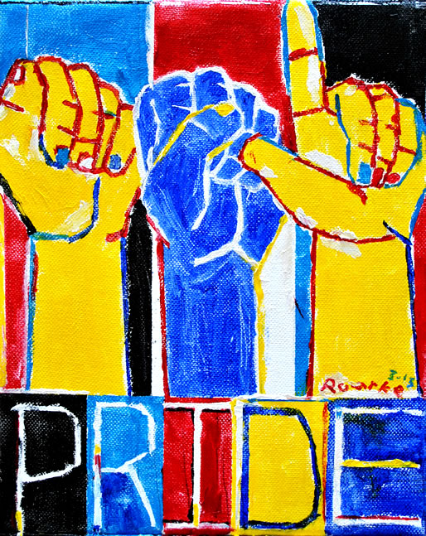
Affirmative Art Deaf Pride, Deaf Culture
Deaf Culture Deaf Pride

Slide 32
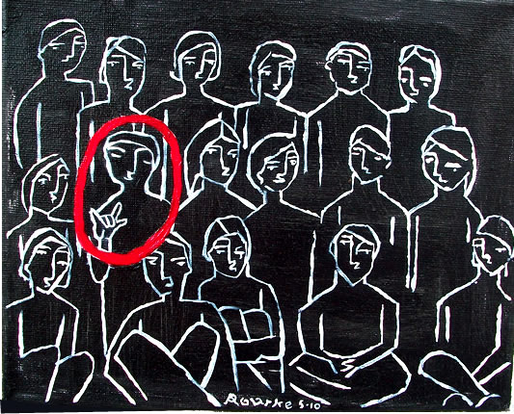
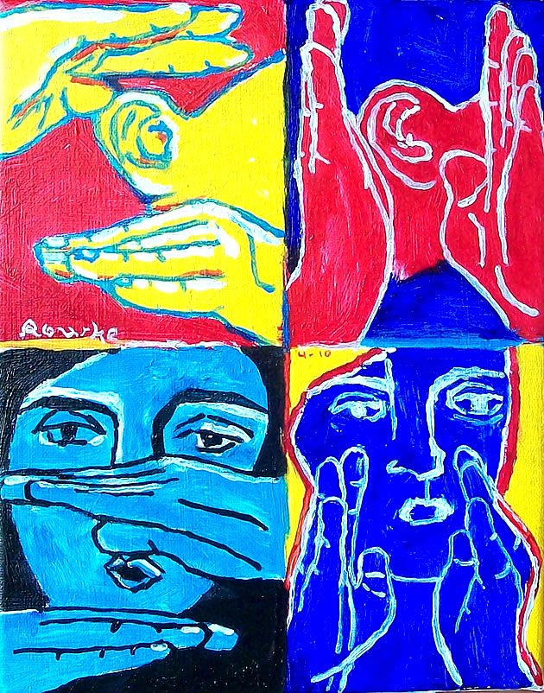
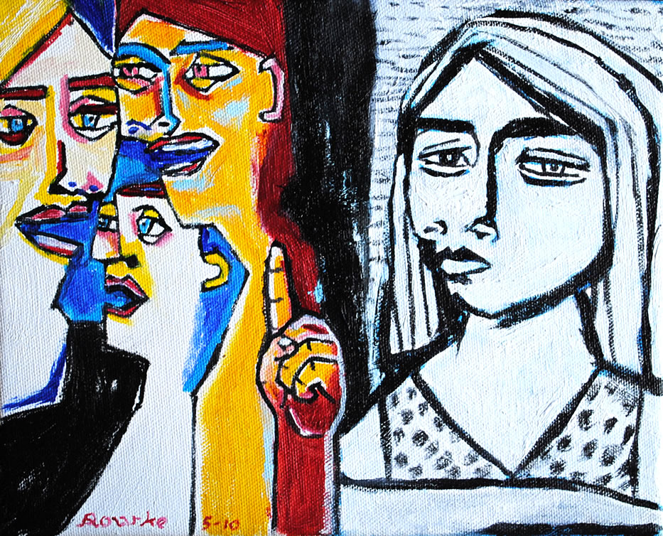
Resistance Art Truth to be Told.
Mainstream
Audism
Neglected

Slide 33
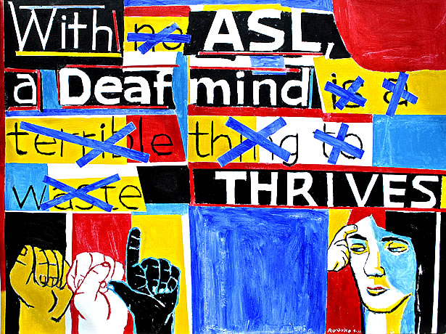
Liberation Art (affirmative & resistance combined)

Slide 34
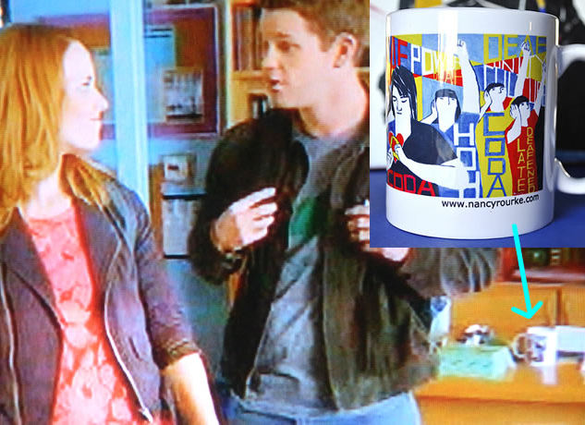
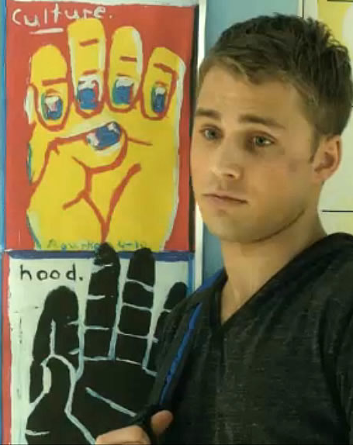
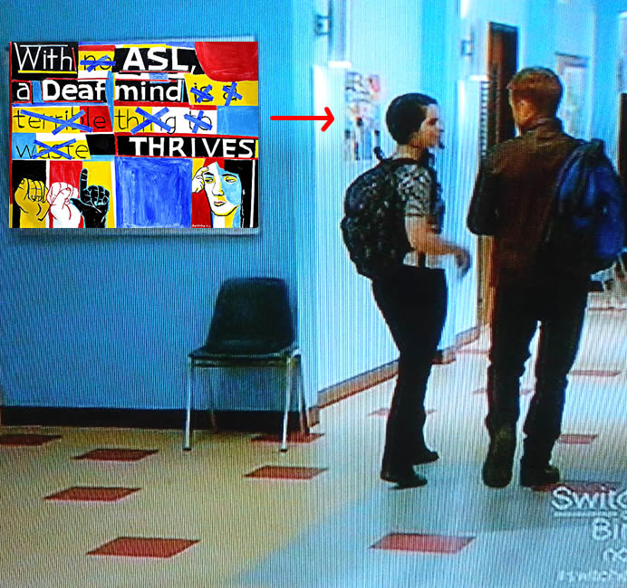
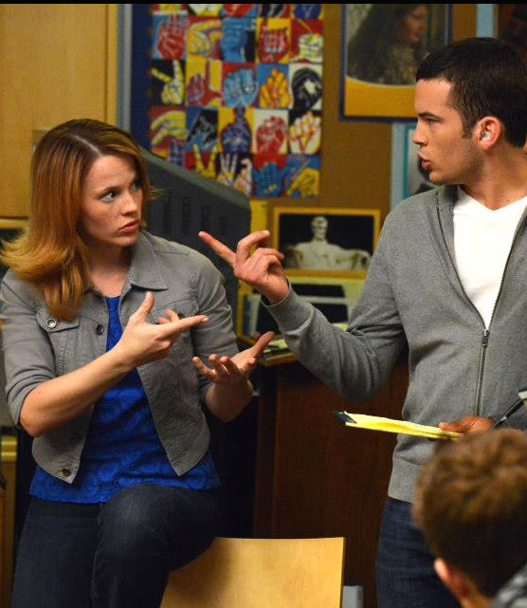
Seven paintings shown on ABC Family Channel ‘Switched at Birth’ 2013

Slide 35
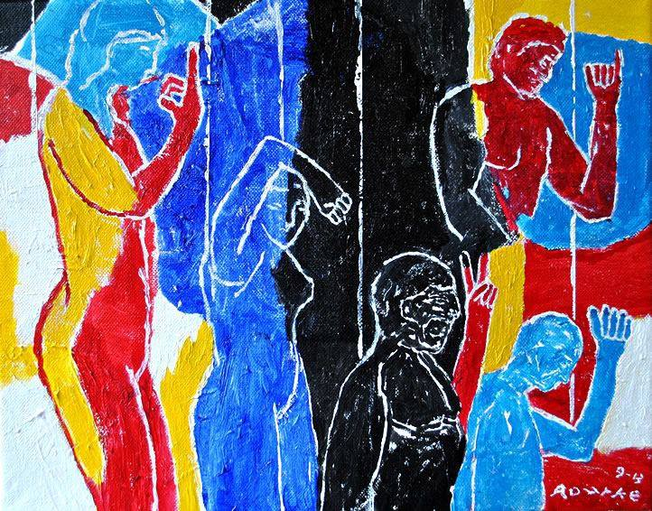
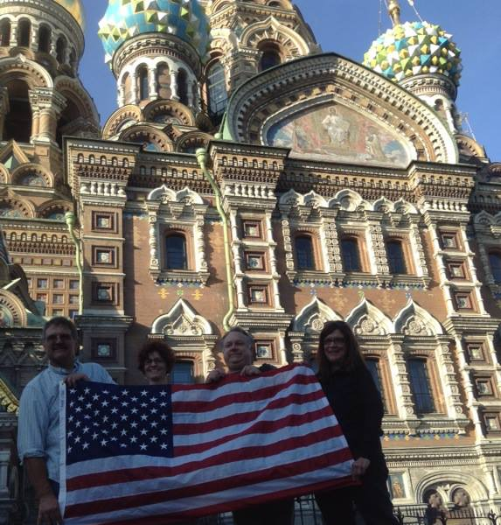
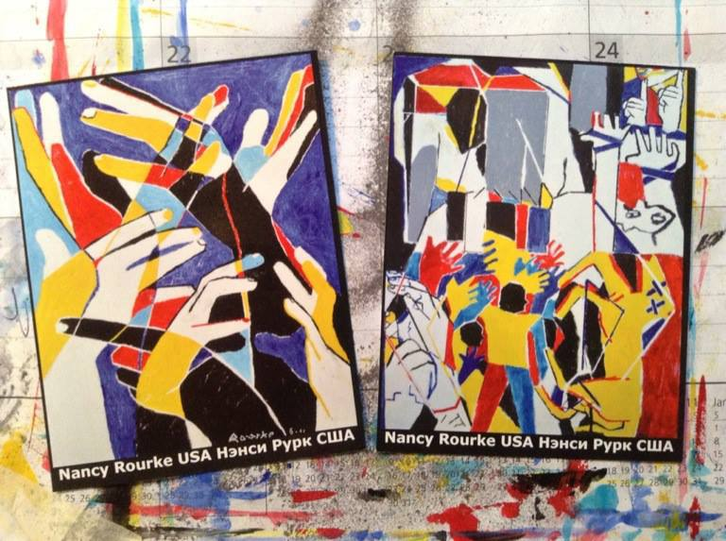
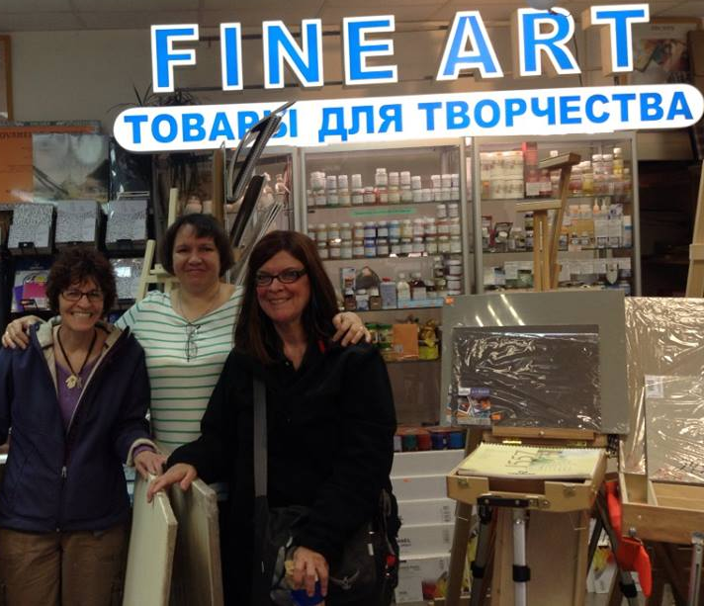
Four De’VIA artists and I were invited
to showcase our paintings at the International
Deaf Art Exhibition in Saint Petersburg, Russia.

Slide 36
Your Project with Nancy Rourke
1. Theme will be:
Educate the Hearing World about Deaf Culture and Sign Language and Deaf Pride.
2. Colors must be in:
Red, Yellow, Blue and Black & White.
3. MOTIFS will be used for AFFIRMATIVE.

Slide 37
Thank you

