Slide 1
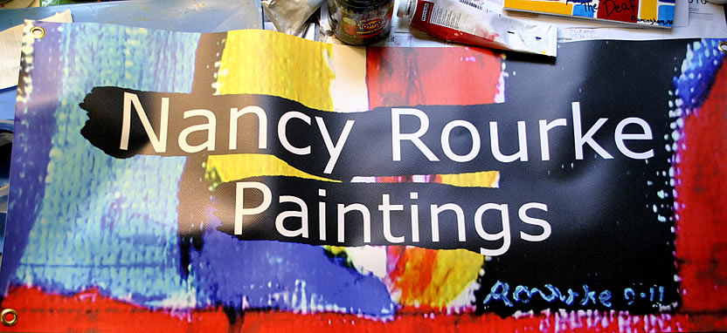
Kendall School for the Deaf – Elementary May 4, 2015

Slide 2
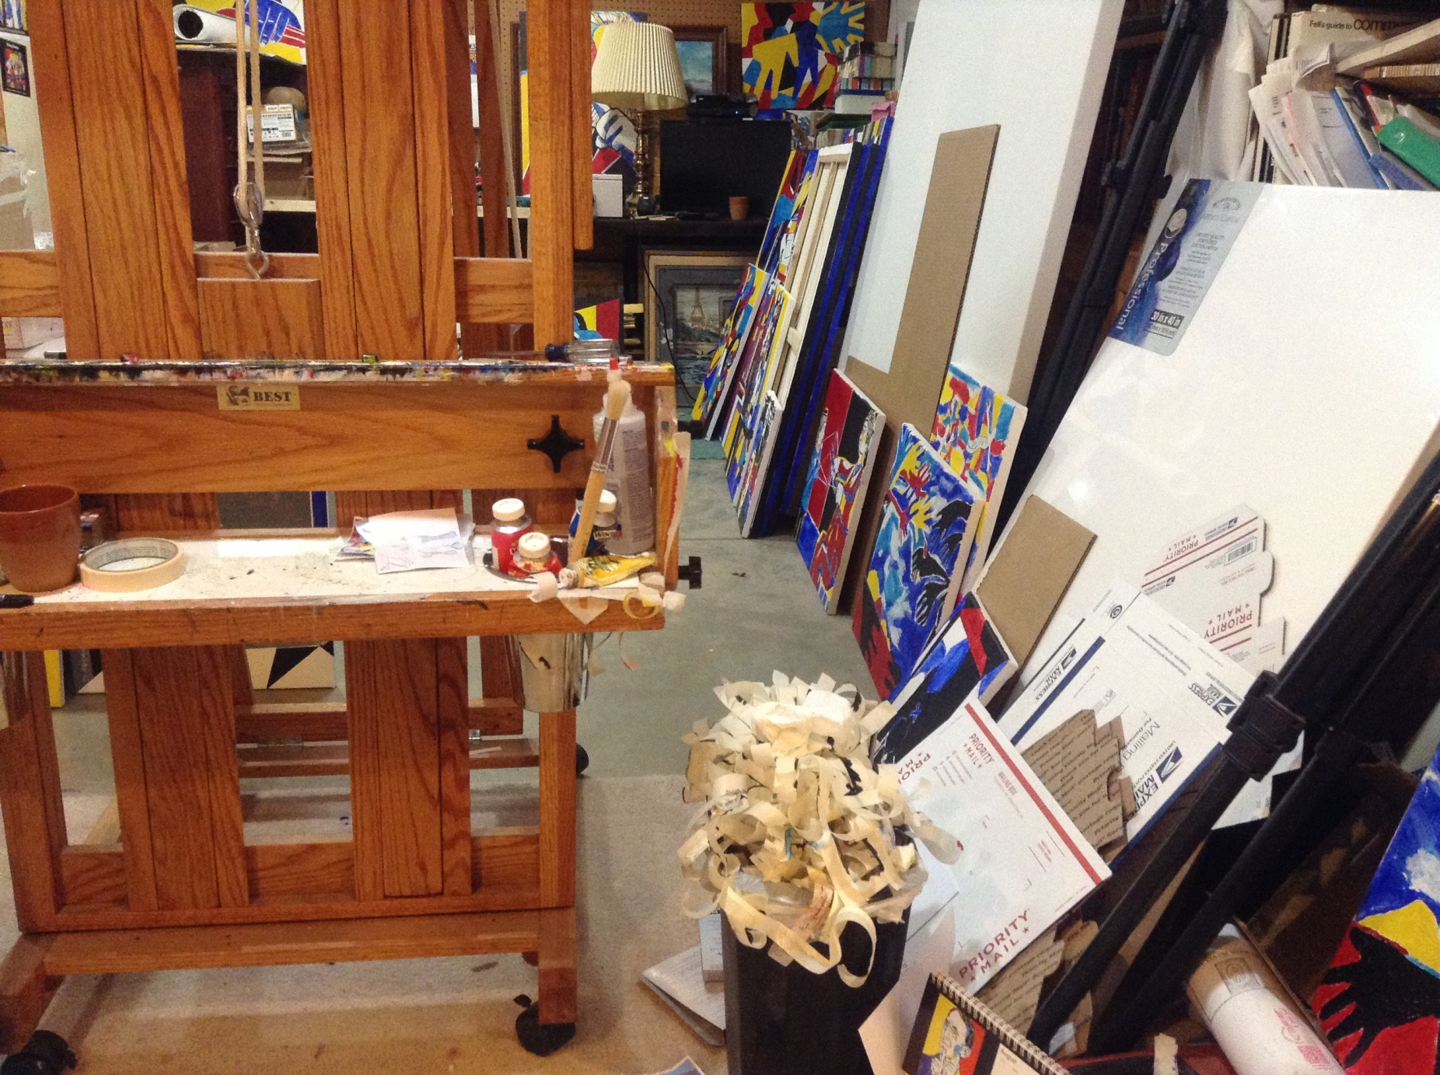
My studio

Slide 3
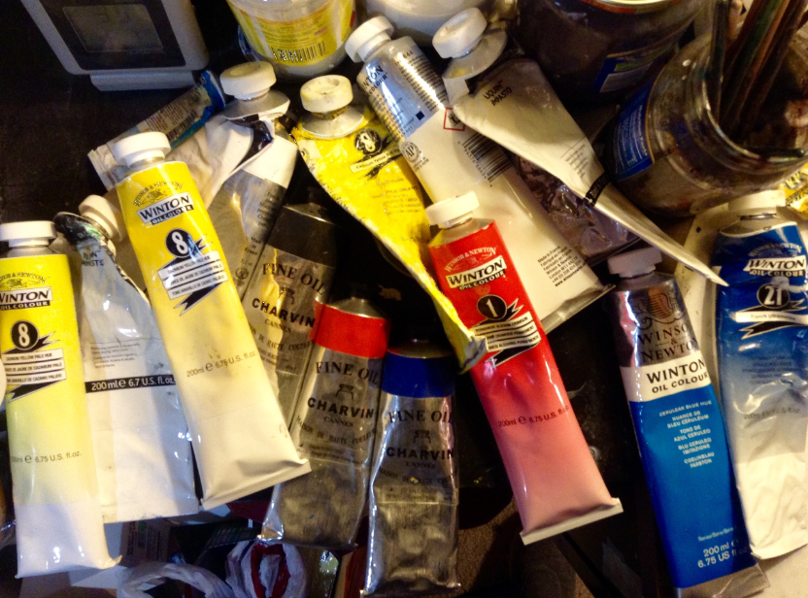

Slide 4
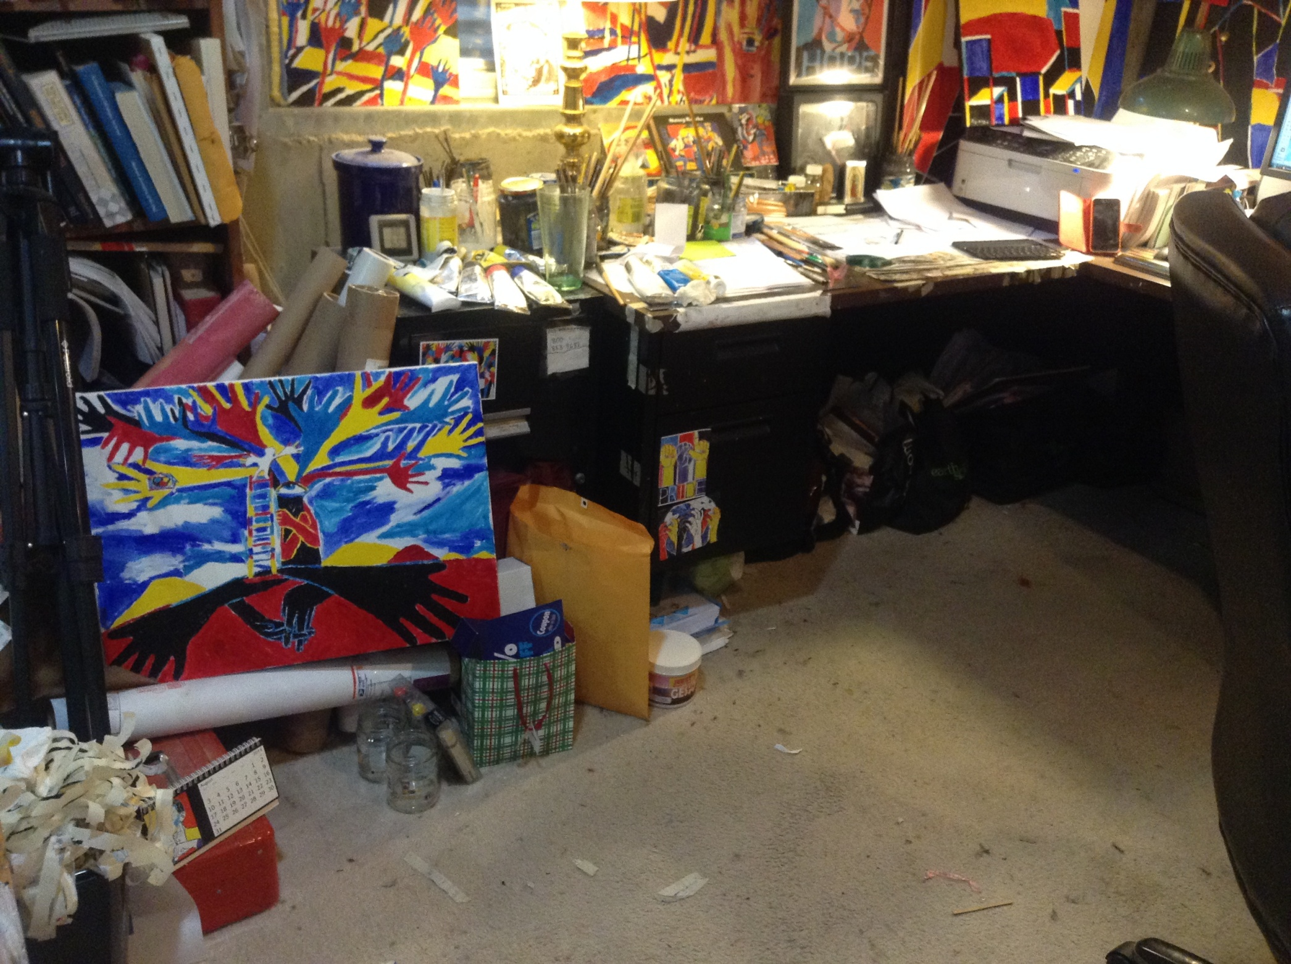

Slide 5
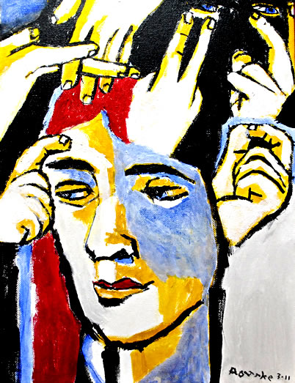
My Art Life

Slide 6
I was born Deaf and I learned to paint when
I was 6 years old.
I went to mainstreamed/oral school.
I went to Rochester Institute of Technology in
Rochester, New York and received 3 degrees in
graphic design and painting.
I was a graphic designer for Xerox, IBM,
20th Century Fox and Microsoft.
I became a full time painter in 2001.

Slide 7
Today’s De’VIA 2010-Present
2013 De’VIA Mural ARTivism

Slide 8
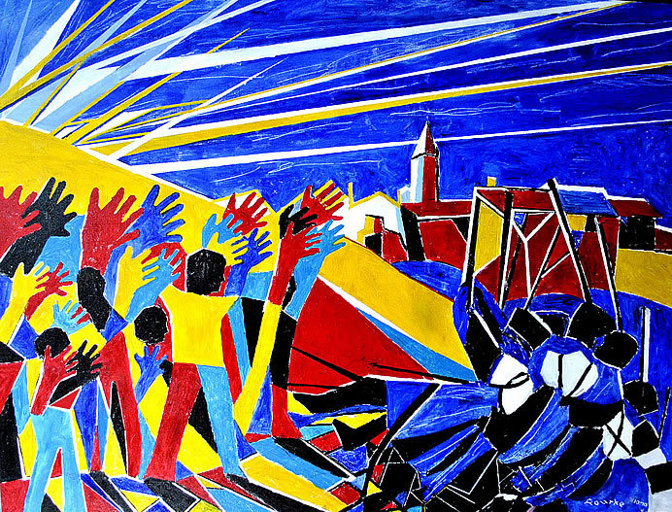
Second Wave of De’VIA Artists
David Call
Ellen Mansfield
Hinda Kasher
Nancy Rourke
and many
more.

Slide 9
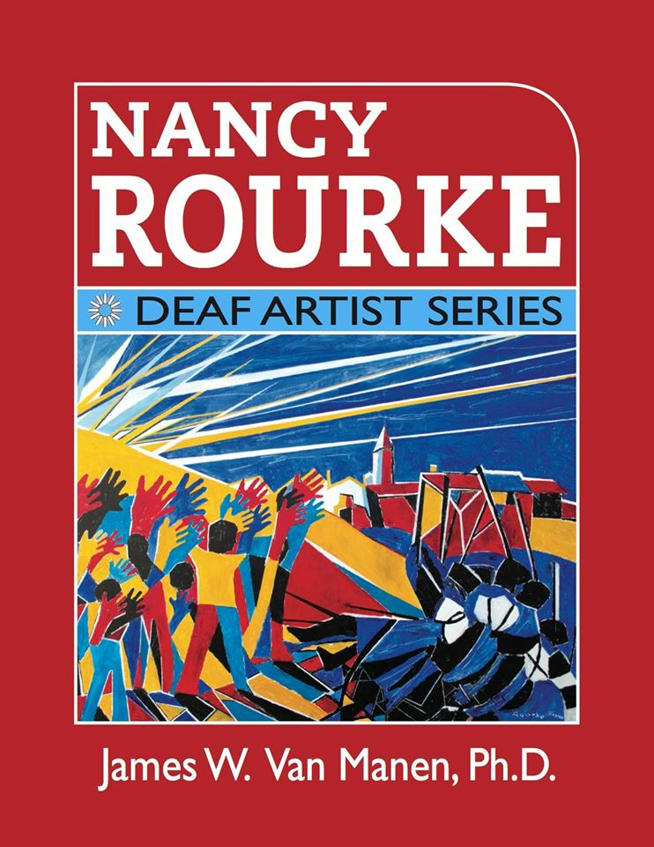
Nancy Rourke: Deaf Artist Series book

Slide 10
Primary Colors
Each color has its own meanings.
Red- refers to power or taking a stand for justice.
Blue- refers to audism, oralism, and the mask of benevolence.
Turquoise blue- refers to Deafhood journey.
Yellow-refers to light so Deaf people can see, and HOPE.
Monochrome can be both resistance and it gives a reinforcement to provide contrast between the primary colors.

Slide 11
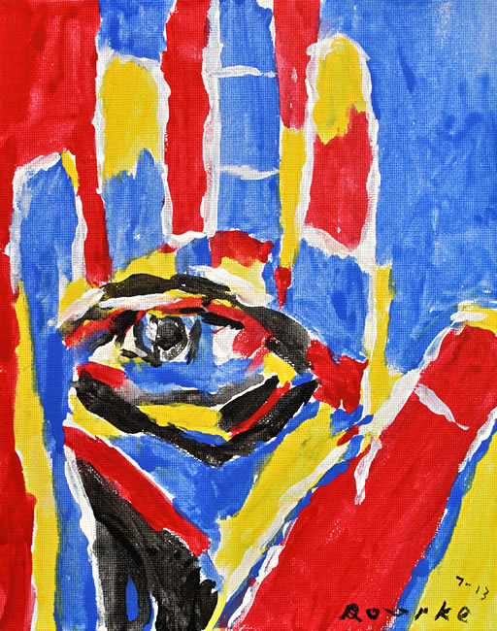
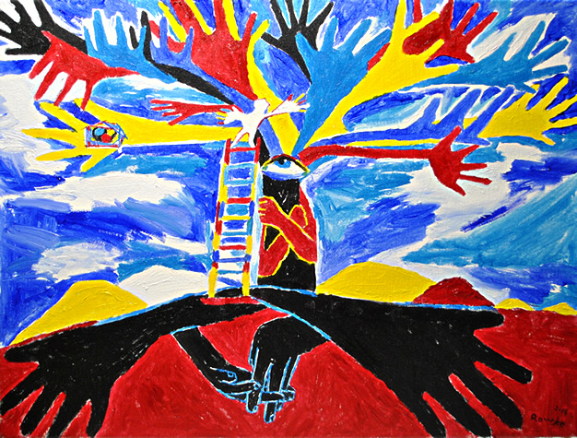
Motifs in My Paintings
Hand- Deaf people, Deaf pride, Deaf culture, sign language.
Eye- Deaf people can see.
Notes:
11

Slide 12
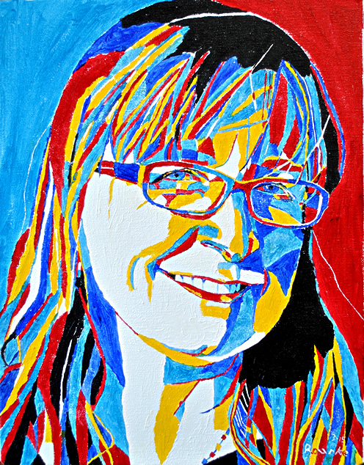
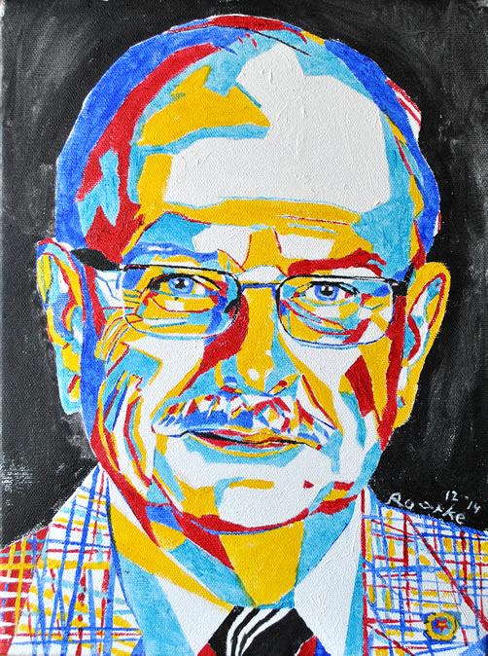
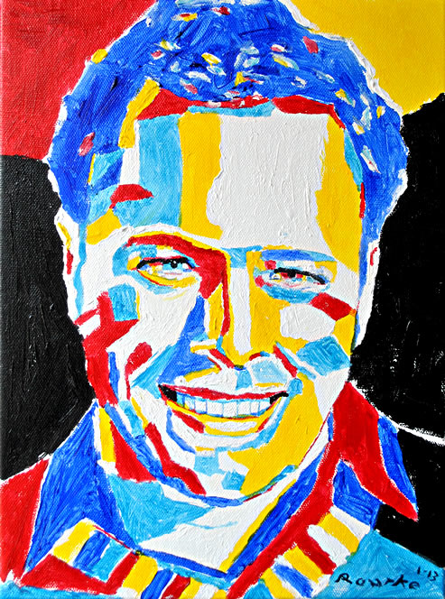
My Trademark
RED, YELLOW and BLUE
Red/Blue Eyebrows
Notes:
12

Slide 13
Portraits

Slide 14
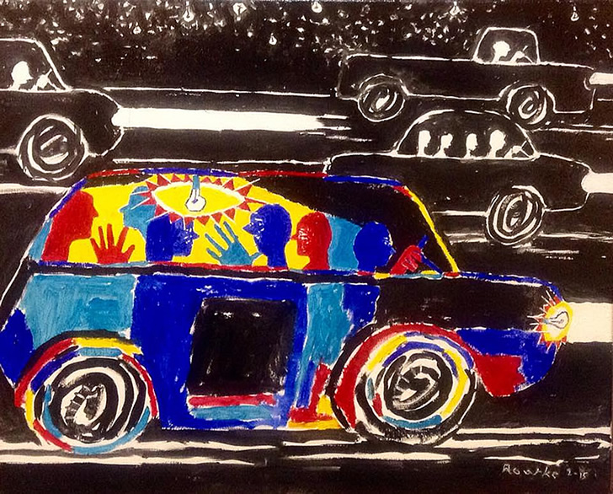

Slide 15
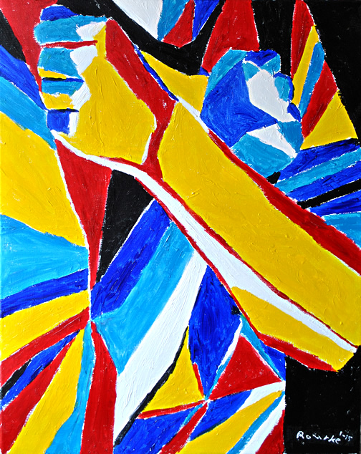

Slide 16
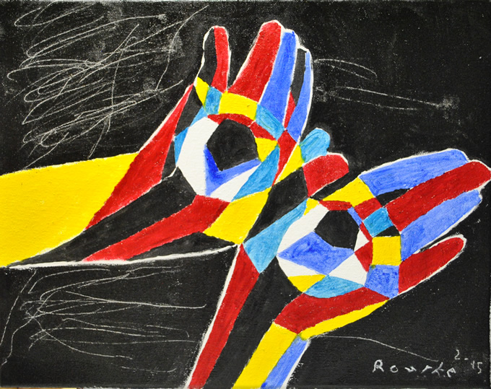

Slide 17
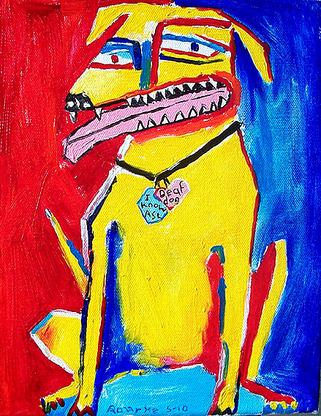

Slide 18
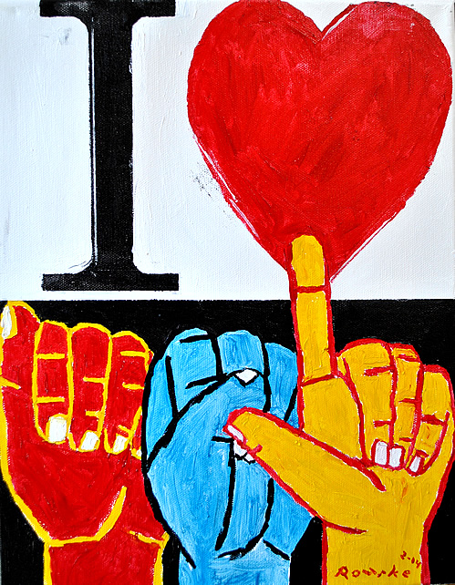

Slide 19
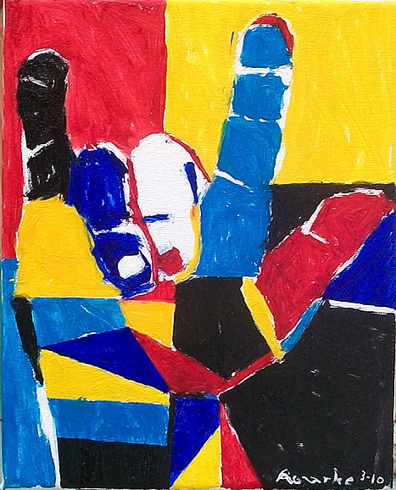

Slide 20
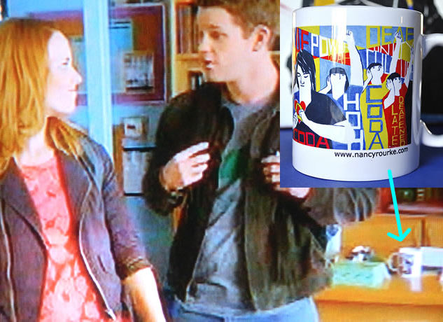
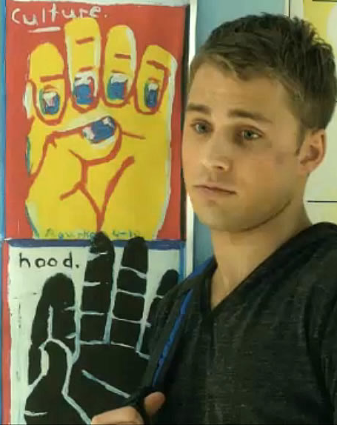
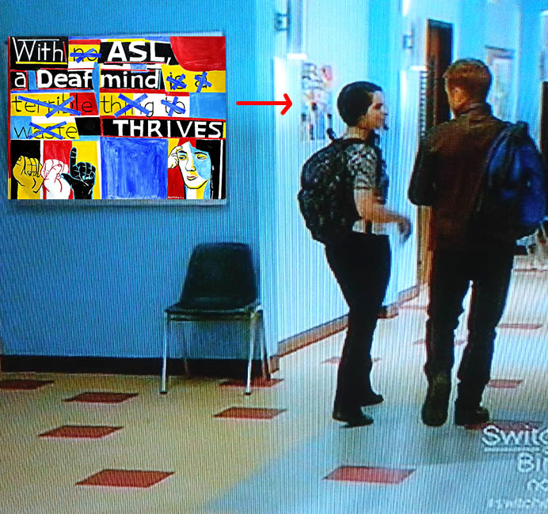
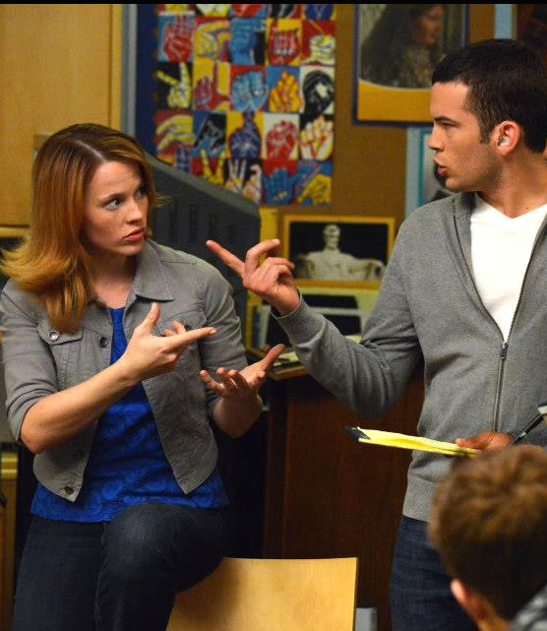
Seven paintings shown on ABC Family Channel ‘Switched at Birth’ 2013

Slide 21
Thank you

