Slide 1
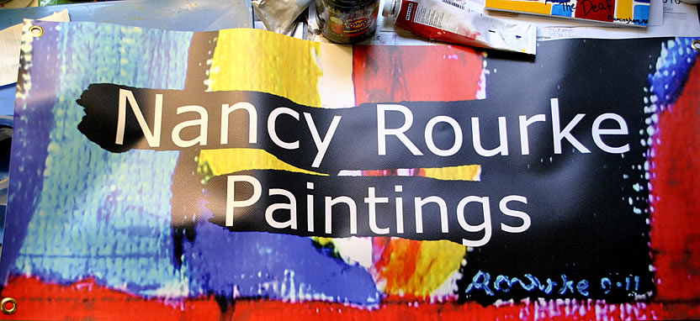
Third Annual at DeafFest Mississippi May 9, 2015

Slide 2
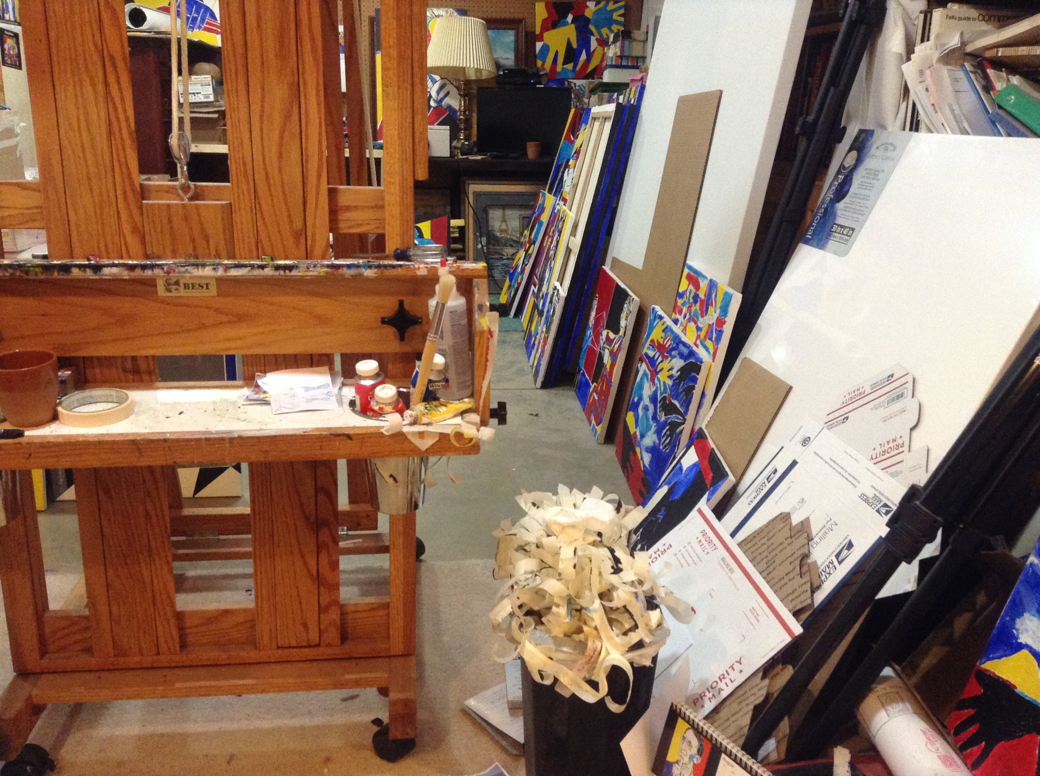
My studio

Slide 3
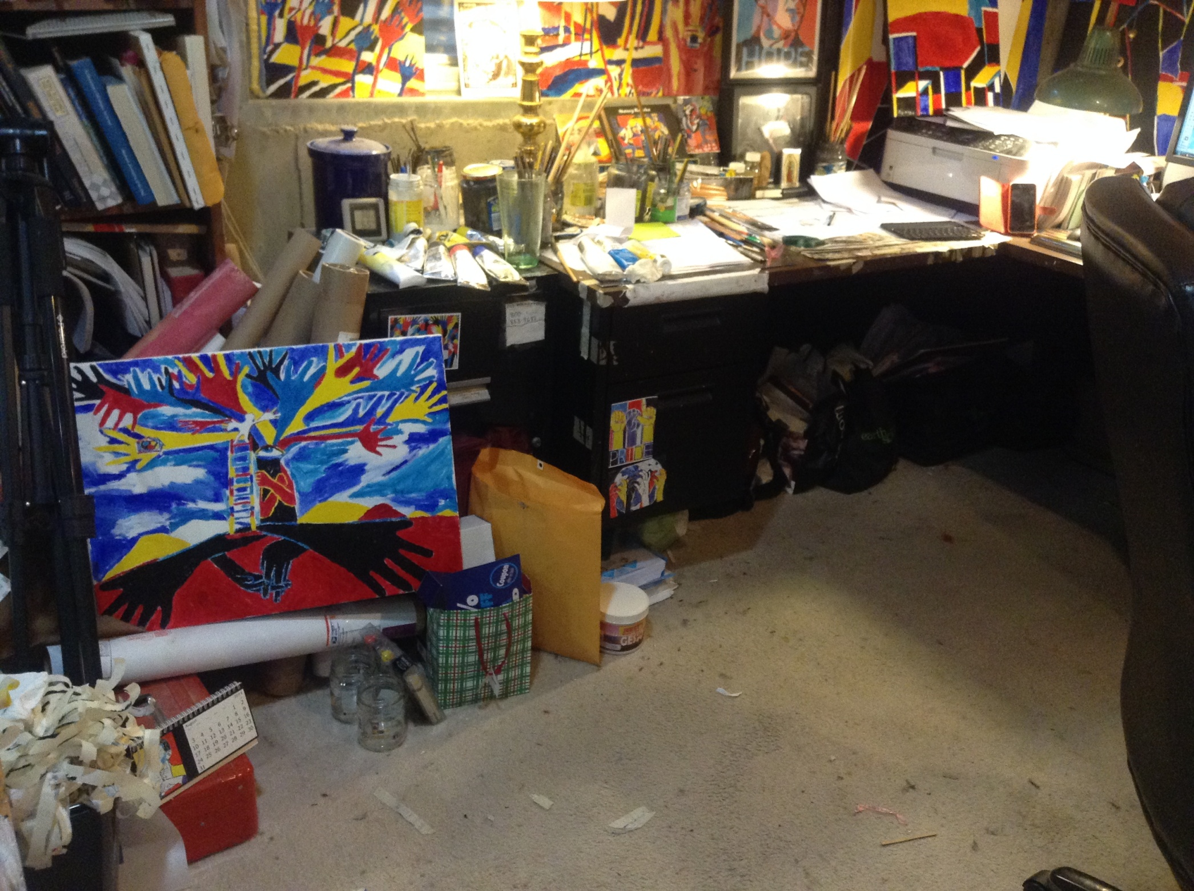

Slide 4
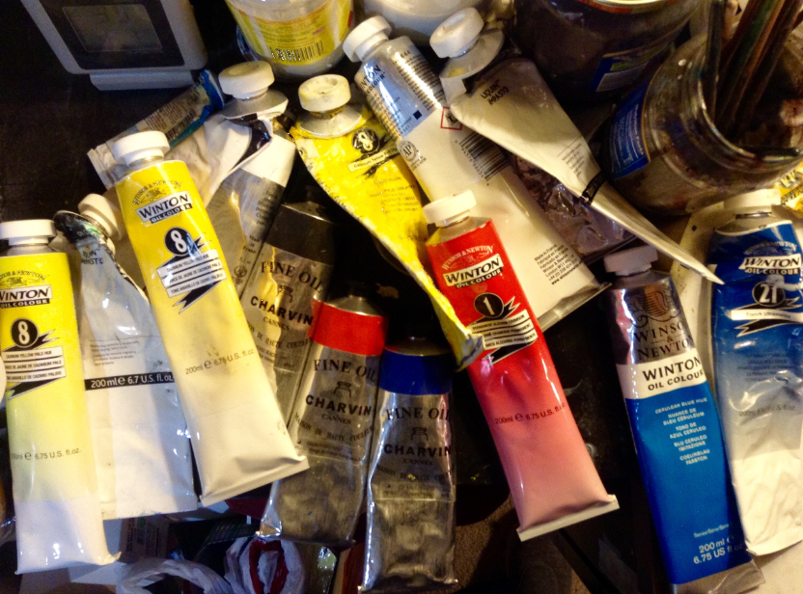

Slide 5
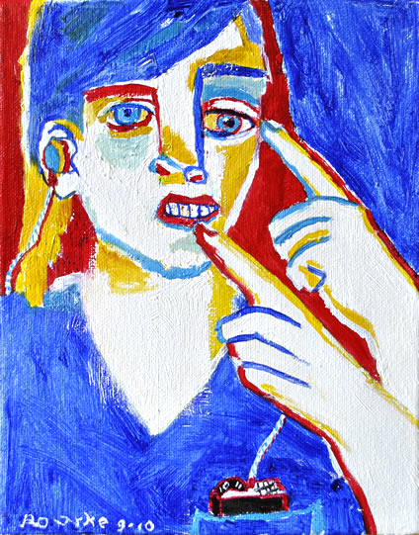
My First Portrait

Slide 6
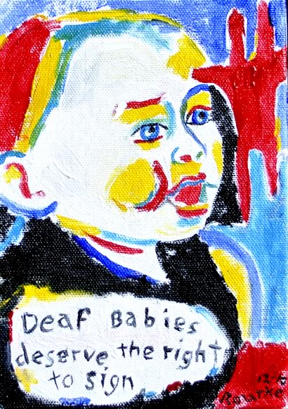
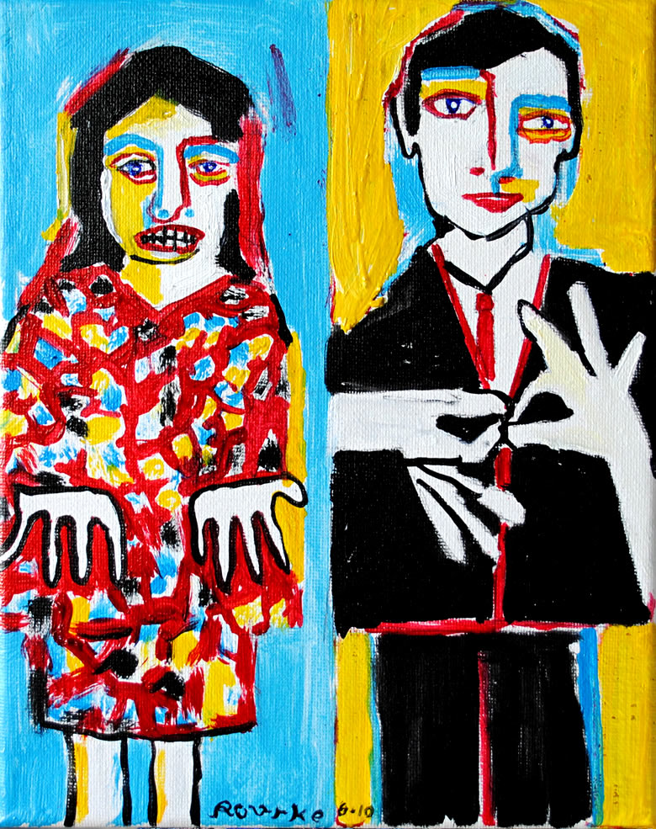
2010

Slide 7
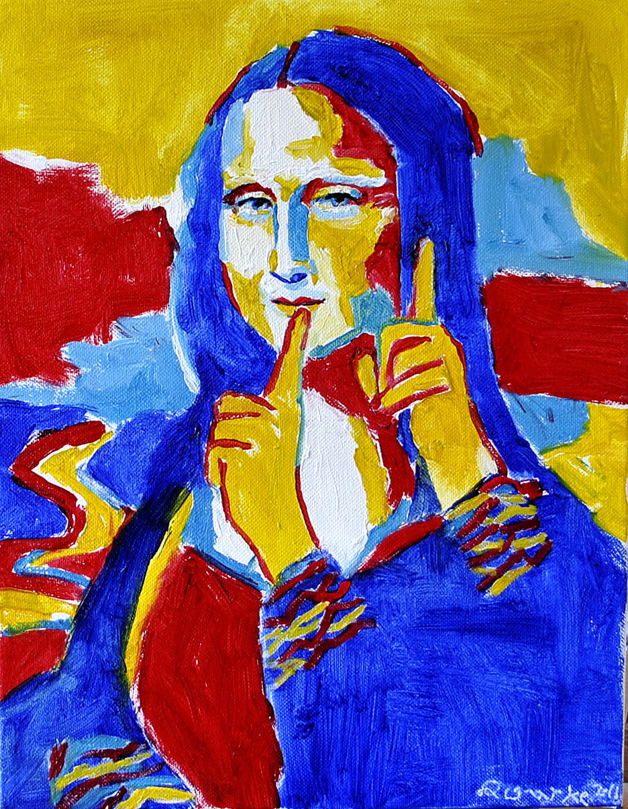
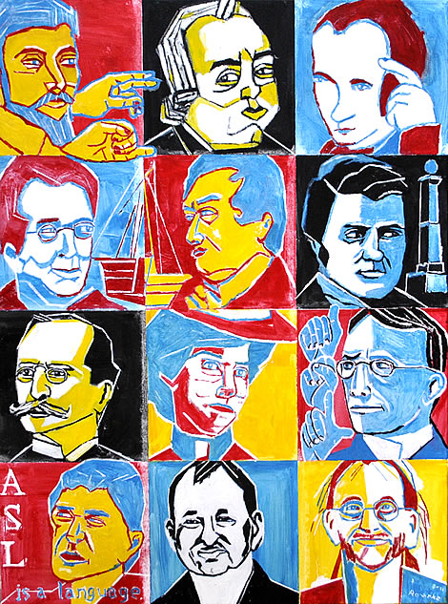
2011

Slide 8
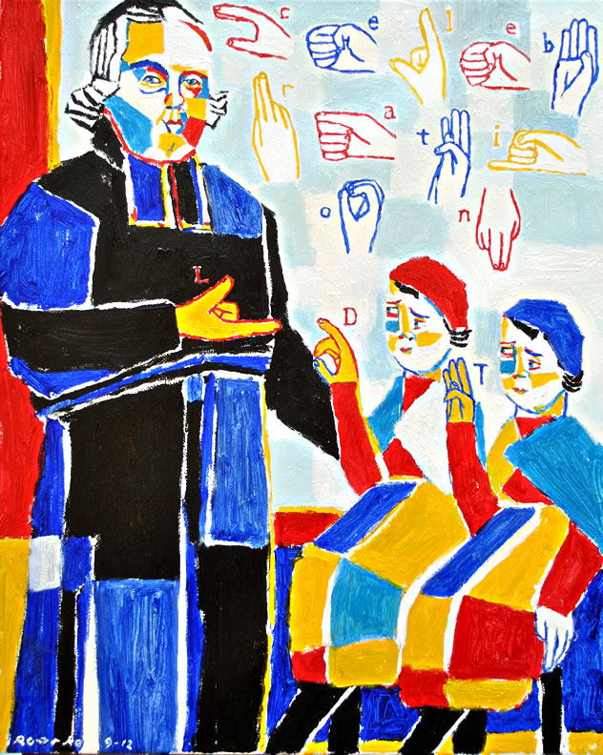
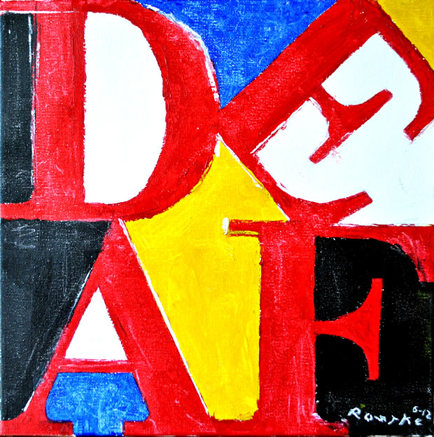
2012

Slide 9
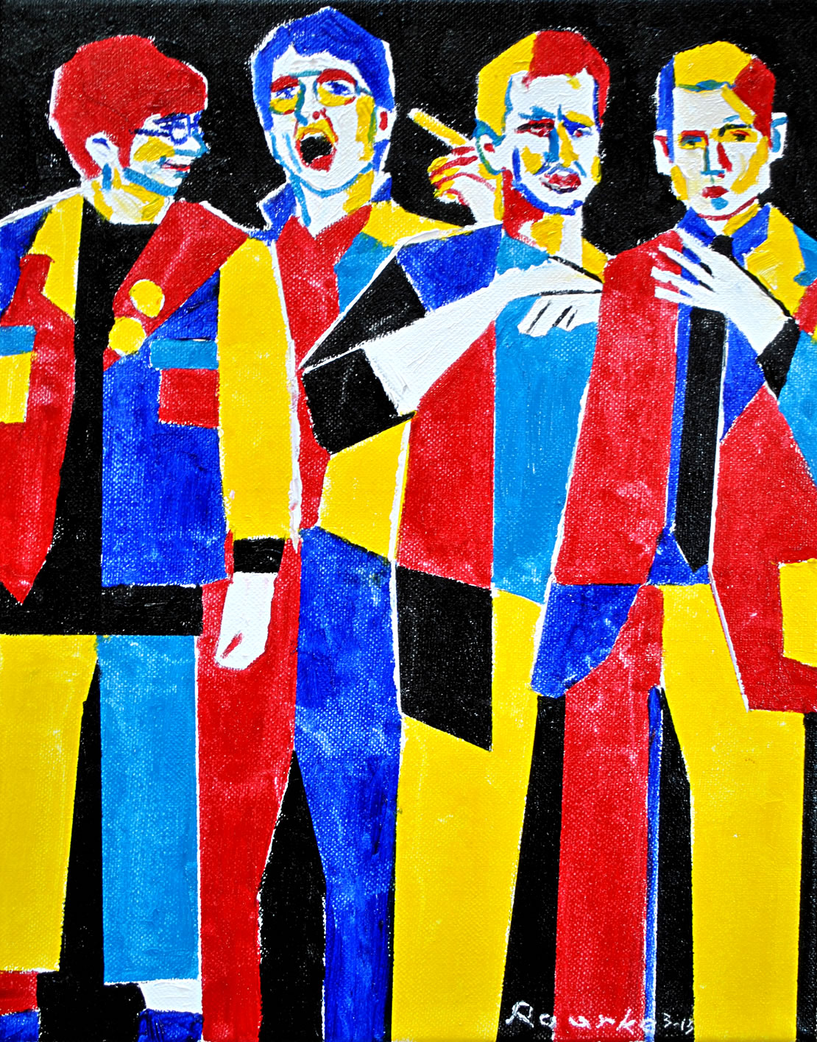
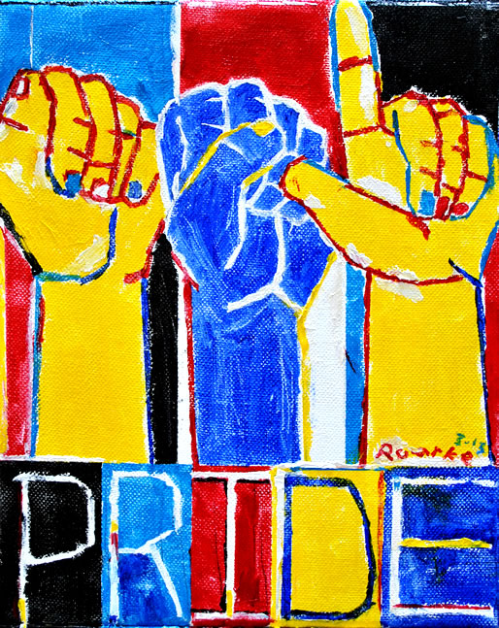
2013

Slide 10
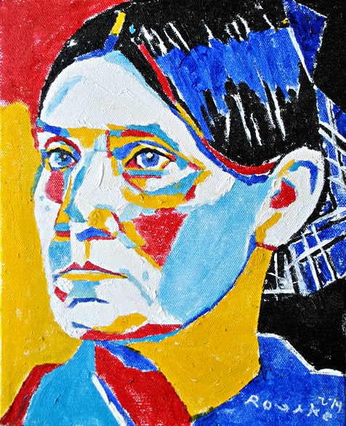
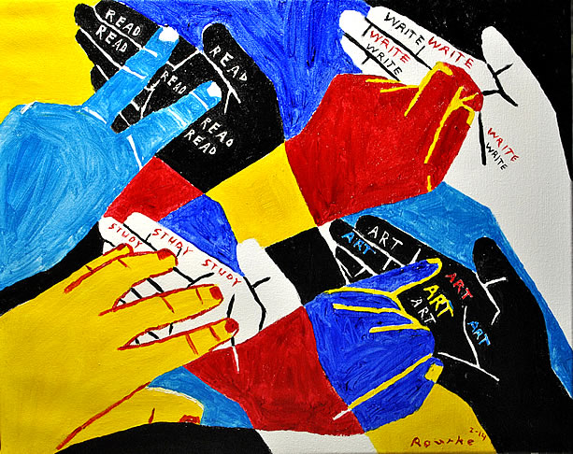
2014

Slide 11
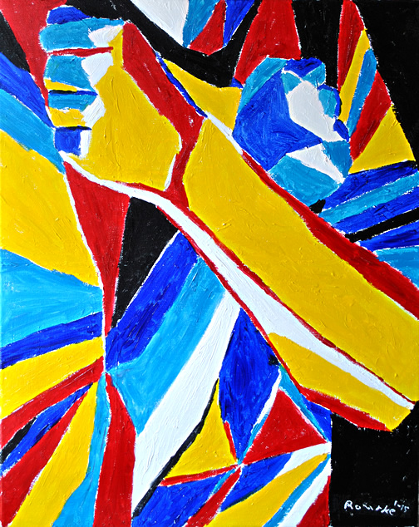
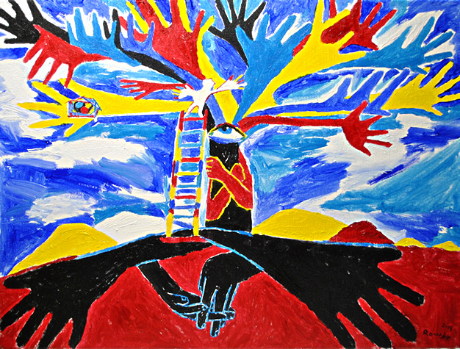
2015

Slide 12
De’VIA stands for:
Deaf View / Image Art.

Slide 13
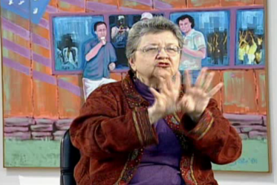
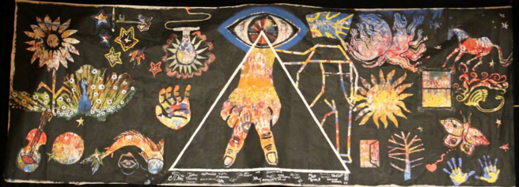
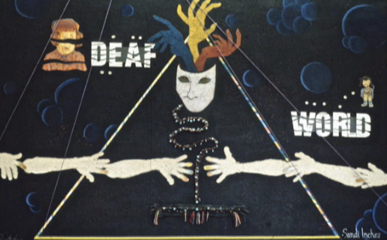
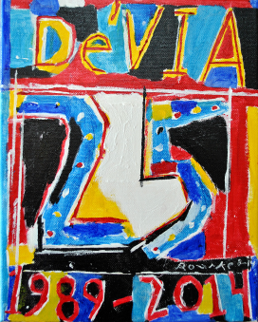
De’VIA TIMELINE
Goya, Tilden, Berthier others DAM Spectrum De’VIA De’VIA Tour ARTivism
1800s
1900s
1960s
1970s
1989 2001-2003 2010-now

Slide 14
How Deaf Education impact Deaf Art:w
--De’VIA Deaf View / Image Art

Slide 16
Today’s De’VIA 2010-Present
2013 De’VIA Mural ARTivism

Slide 17
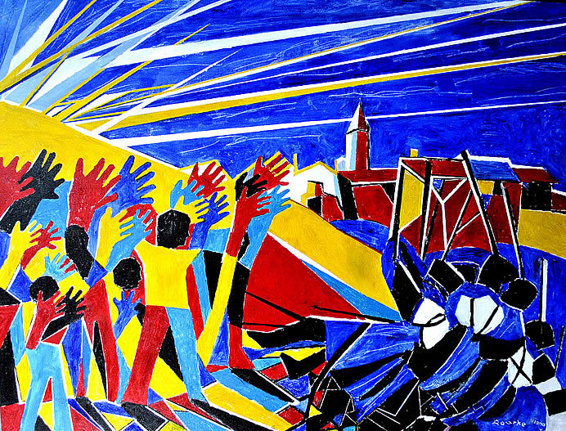
Second Wave of De’VIA Artists
David Call
Ellen Mansfield
Hinda Kasher
Nancy Rourke
and many
more.

Slide 18
Thank you
for watching.

