Slide 1
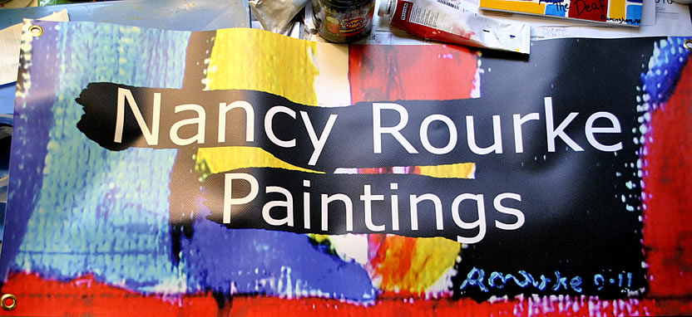
Columbia College with Nancy Rourke September 18-25, 2015

Slide 2
My studio

Slide 3
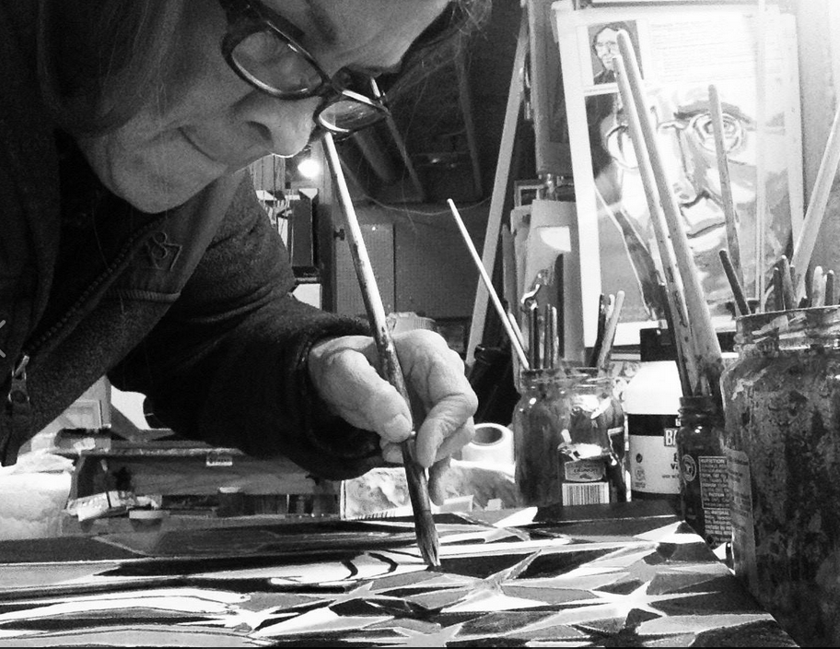

Slide 4
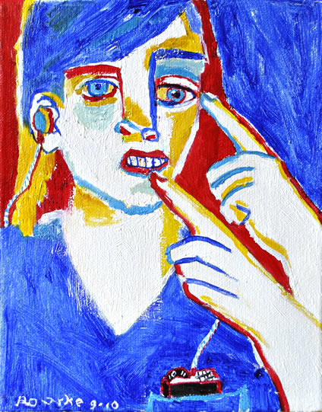
Abit about My Life
Self-Portrait
2010

Slide 5
born Deaf.
started drawing at age 6.
mainstreamed/oral school.
graduated from RIT/NTID in graphic design and painting.
graphic designer for Xerox, IBM, 20th Century Fox and Microsoft for 20 years.
full time painter in 2001.
De’VIA artist in 2010.

Slide 6
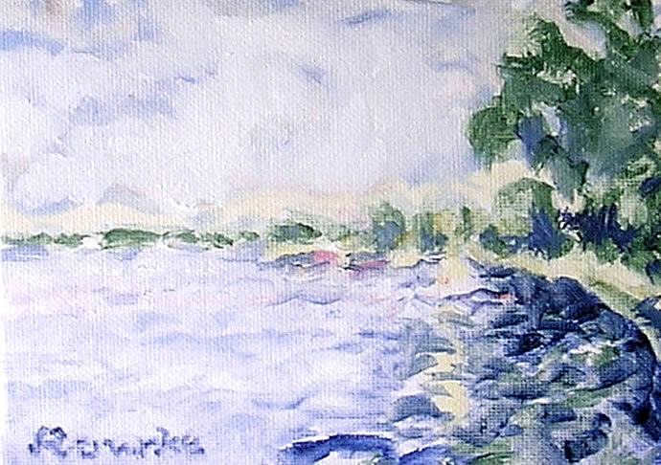
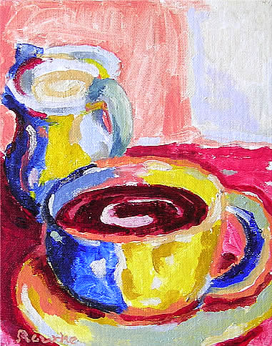
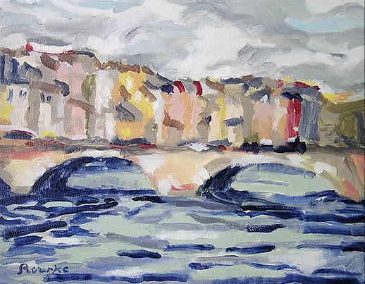
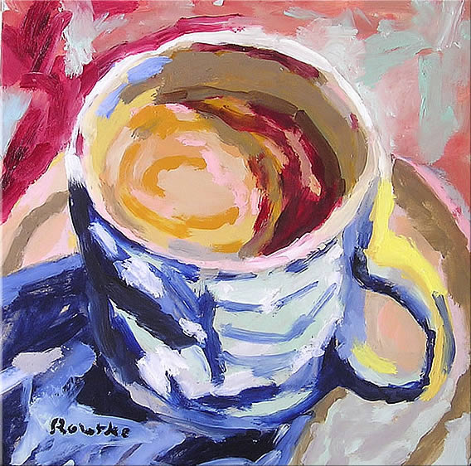
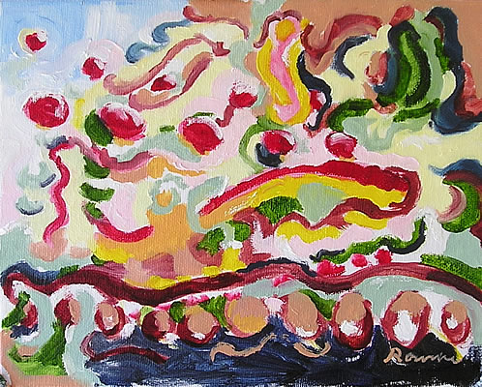
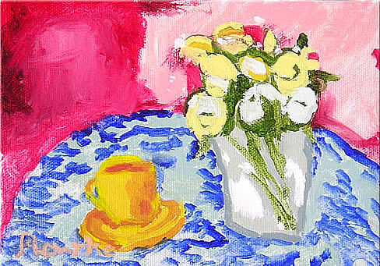
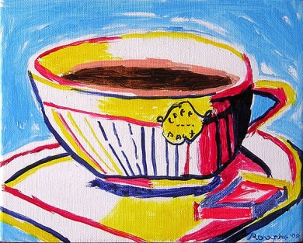
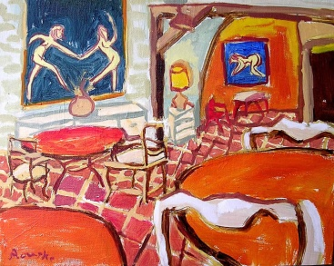
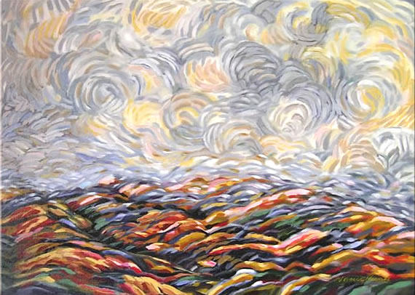
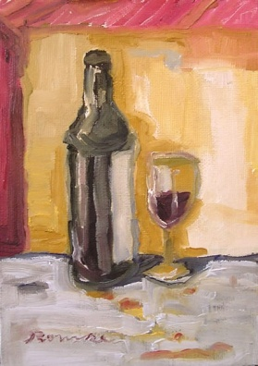
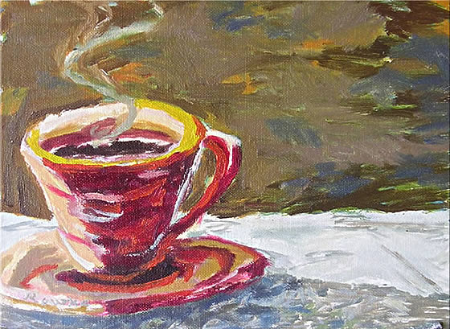
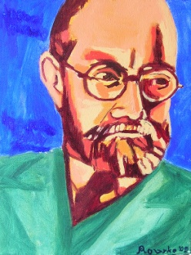
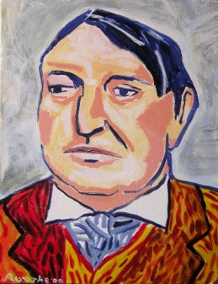
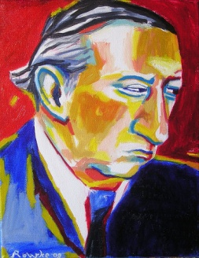
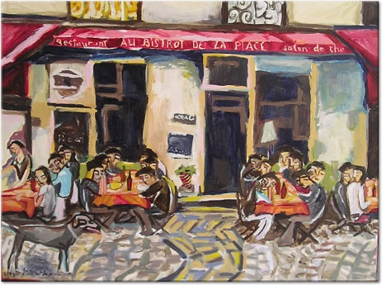
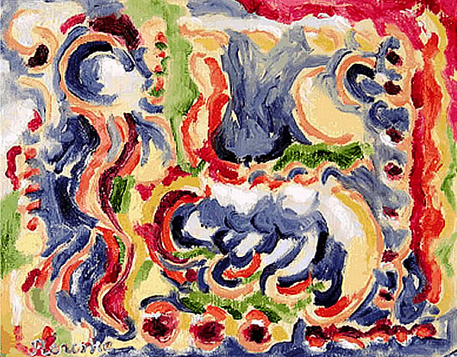
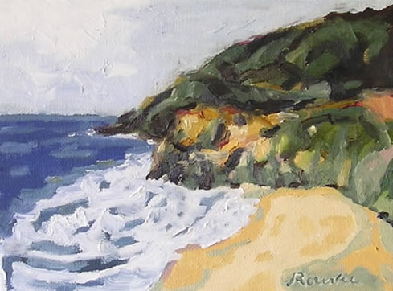
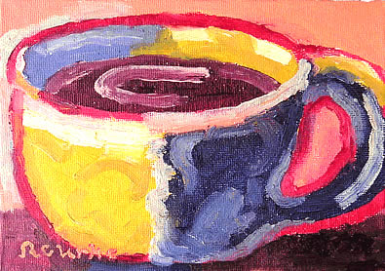
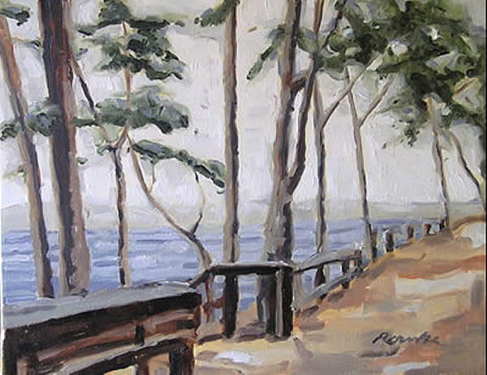
Early paintings from 2001-2009.

Slide 7
2010-2015

Slide 8
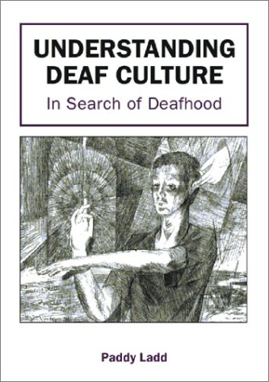
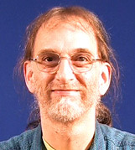
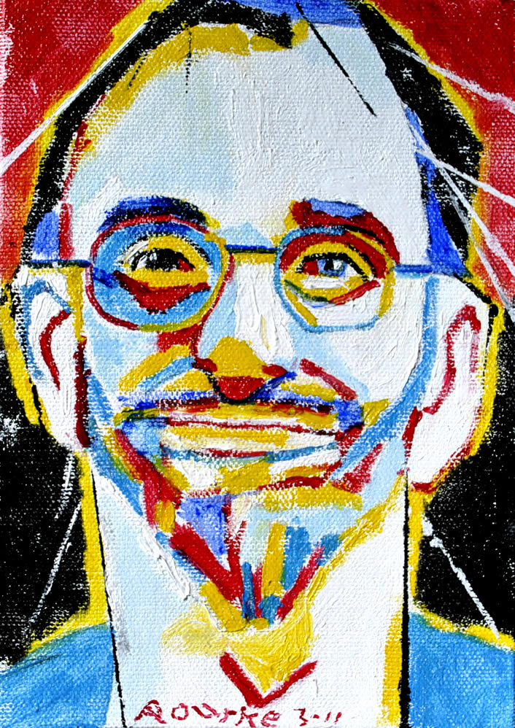
Prior to 2010
I was inspired by Paddy Ladd’s book, and made a proposal
about Deaf Art (De’VIA). I received a Puffin Foundation
grant to start a painting business.
Dr. Paddy Ladd

Slide 9
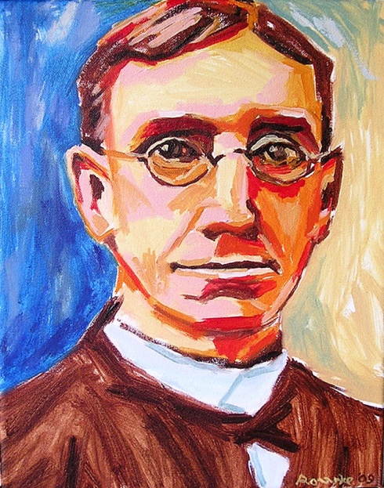
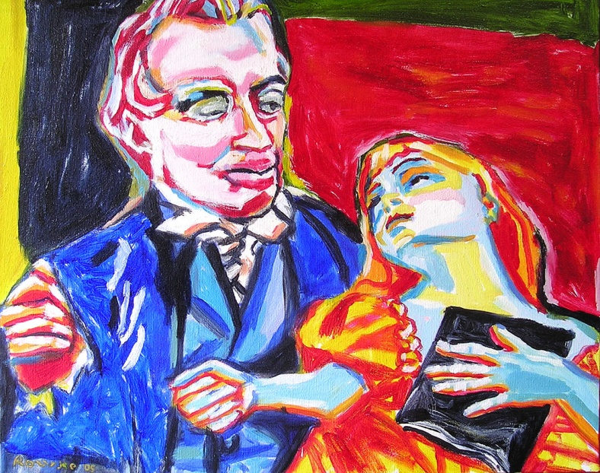
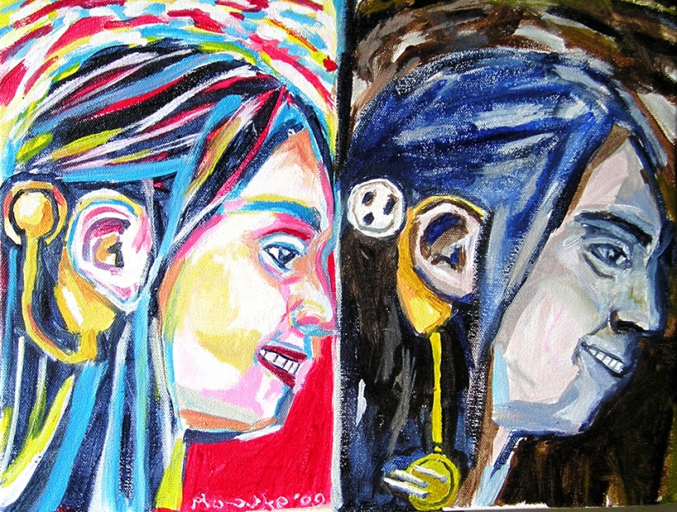
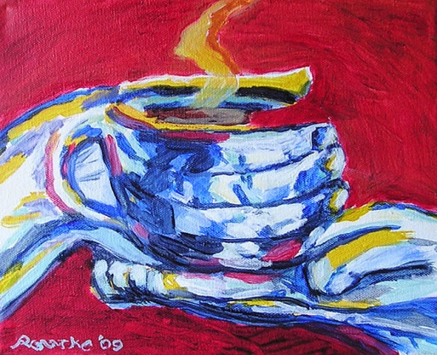
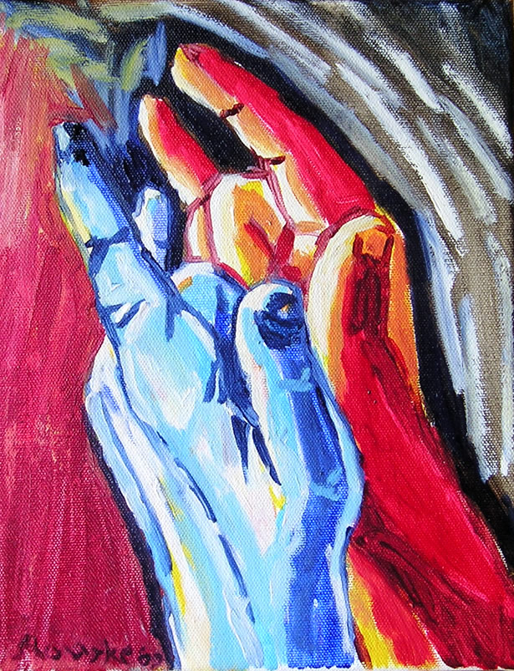
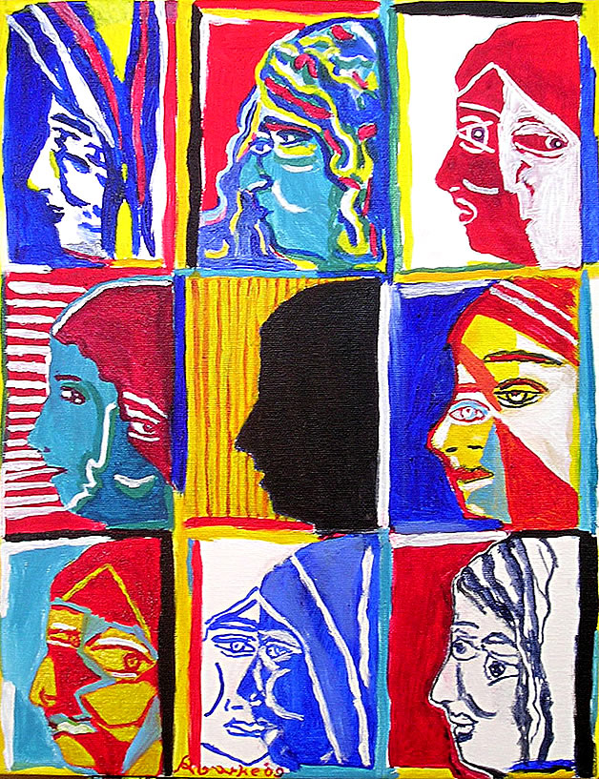
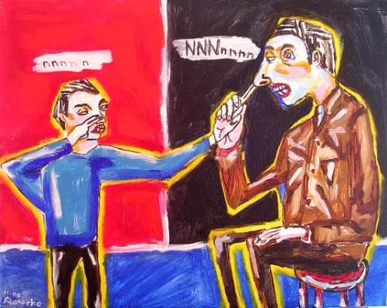
Prior to 2010
Experimenting
with colours.
Searching for
a style.

Slide 10
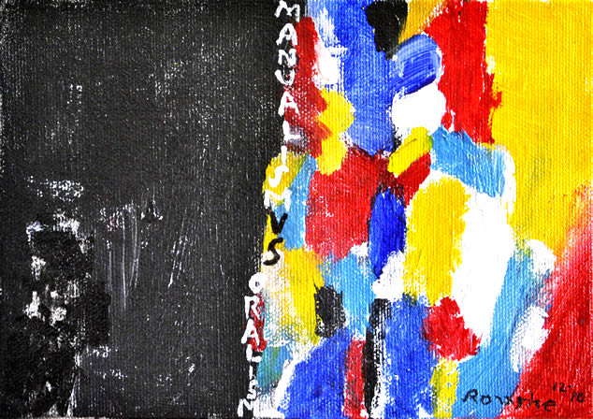
Primary Colors
Each color has its own meanings.
Red- refers to power or taking a stand for justice.
Blue- refers to audism, oralism, and the mask of benevolence.
Turquoise blue- refers to Deafhood journey.
Yellow-refers to light so Deaf people can see, and HOPE.
Monochrome can be resistance except it gives a reinforcement to provide contrast between the primary colors.

Slide 11
3 Things I see about De’VIA
Deaf View / Image Art
1 De’VIA is based on Deaf experience.
2 Motifs are used in artwork.
3 Three categories are used in artwork:
1 Affirmative (pride, identity)
2 Resistance (political, truth to be told)
3 Liberation (both of the two themes above)
Notes:
11

Slide 12
Over 100 Motifs are used in De’VIA
chain, resistance light bulb, affirmative feather, resistance hand, affirmative mirror, resistance handstand, affirmative lock, resistance flower, affirmative profit, resistance butterfly, affirmative jigsaw puzzle, resistance candle, affirmative AGB, resistance ladder, affirmative blue tape, resistance eyes, affirmative hook, resistance tree, affirmative mask, resistance baby, affirmative nails or screws, resistance hands holding, affirmative
puppet, resistance solitary fist, affirmative octopus, resistance door, affirmative checkerboard, resistance round table, affirmative
Strings, resistance
Sledgehammer, resistance
Violin, affirmative
Elephant, resistance
Birdhouse, affirmative
Arrow, resistance
Nest, affirmative
Button eye, resistance
Plague doctor, resistance
Money bag, resistance
Gloves, resistance
Mother of All Deaf Souls, affirmative
Skull, resistance
Fan, resistance
Mouth, resistance
Stairway, resistance or affirmative
Handshape, affirmative
Speech therapy, resistance
Fish, affirmative
DNA, resistance
Cracks, resistance
Bandaid, resistance
Chair, affirmative
Hamster, resistance
Black bird, resistance
Red mountain, affirmative
Hearing aid/CI, resistance
Ruler, resistance
Drill, resistance
Harlequin/jester, resistance
Cloven Hooves, resistance
Stars, affirmative
Arrow, resistance
Nest, affirmative
Button eye, resistance
Plague doctor, resistance
Money bag, resistance
Gloves, resistance
Mother of All Deaf Souls, affirmative
Skull, resistance
Fan, resistance
Mouth, resistance
Stairway, resistance or affirmative
Handshape, affirmative
Speech therapy, resistance
Fish, affirmative
DNA, resistance
Cracks, resistance
Bandaid, resistance
Chair, affirmative
Hamster, resistance
Black bird, resistance
Red mountain, affirmative
Hearing aid/CI, resistance
Ruler, resistance
Fish, affirmative
DNA, resistance
Cracks, resistance
Bandaid, resistance
Chair, affirmative
Hamster, resistance
Black bird, resistance
Red mountain, affirmative
Hearing aid/CI, resistance
Ruler, resistance
OVER 100 MOTIFS….

Slide 13
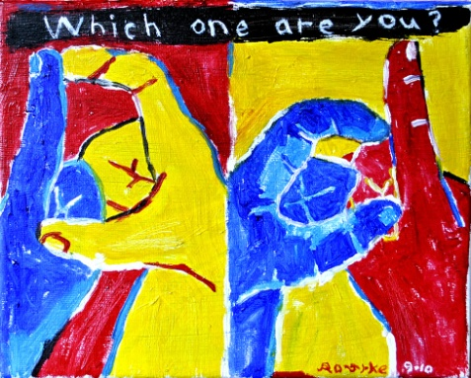
First Motifs Used in Paintings 2010
Big D/little d-------------------------- Culturally Deaf vs. Deafness.
Ear/Mouth--------------------------------------- Audism. Oralism. Genetic engineering. Eugenics. Alexander Graham Bell. Listening, Spoken, Language.
Notes:
13

Slide 14
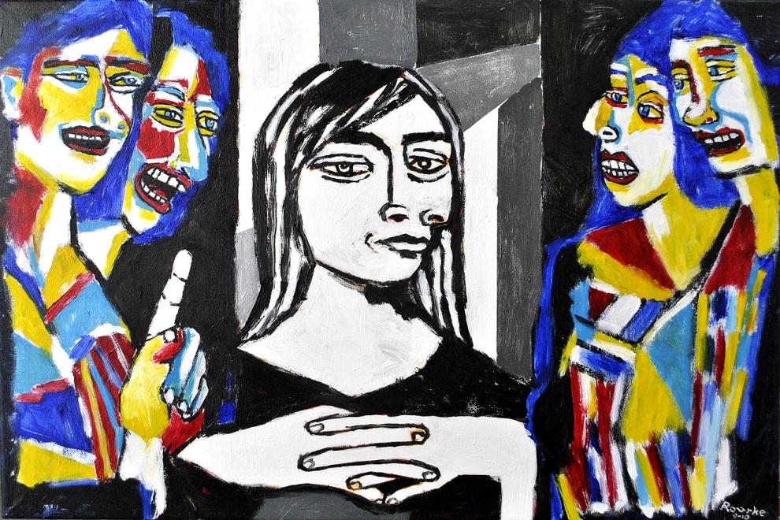
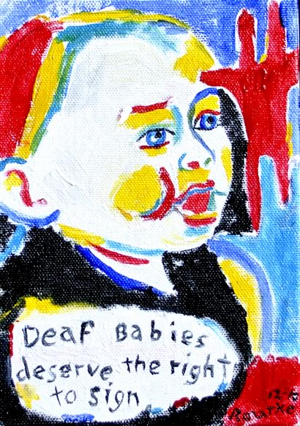
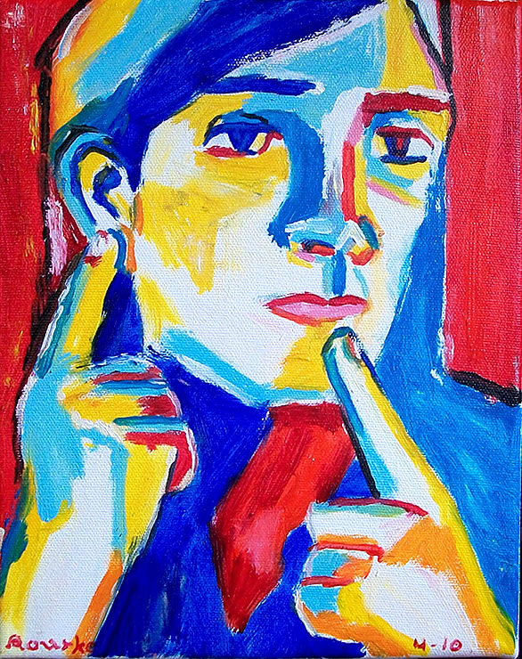
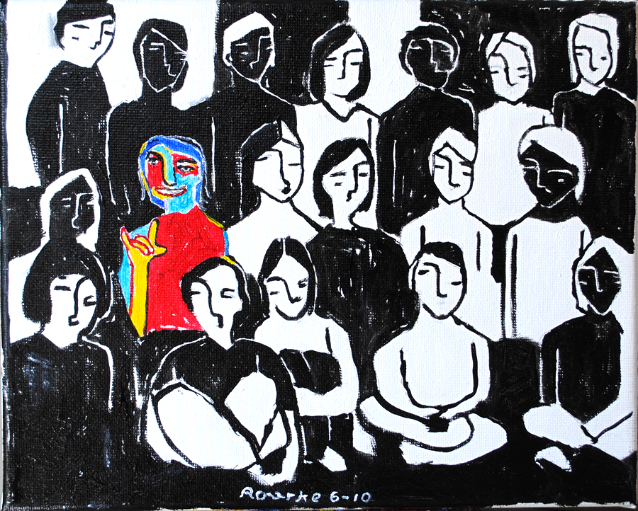
2010

Slide 15
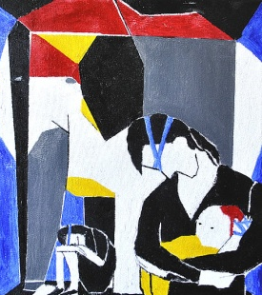
2011 Motifs
Elephant-------------------------------- Alexander Graham Bell and his associates.
Notes:
15

Slide 16
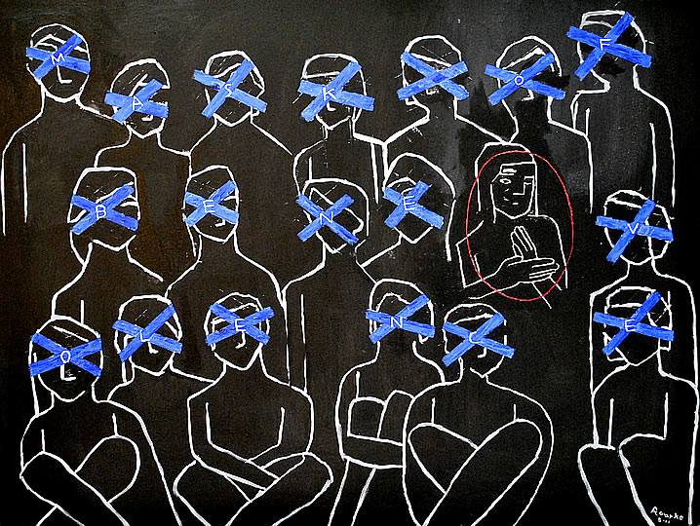
2011 Motifs
Painter’s Blue Tape tied-down, trapped, crossed-out, mask of benevolence, labeled, ASL prohibited.
Mask of Benevolence, size 30x40inch, oil on canvas, 2011.
This painting is about
Mask of Benevolence
by Harlan Lane's
Mask of
Benevolence
book.

Slide 17
There is a hidden message.
F
O
A
S
K
M
E
E
N
V
B
E
L
O
N
C
E
It says MASK OF BENEVOLENCE.

Slide 18
2011 Motifs
I learned about
the blue tape
from Audism Free
America, a grassroots organization in
Washington, DC, 2011.
Alexander Graham Bell
Association for the
Deaf and Hard of Hearing.

Slide 19
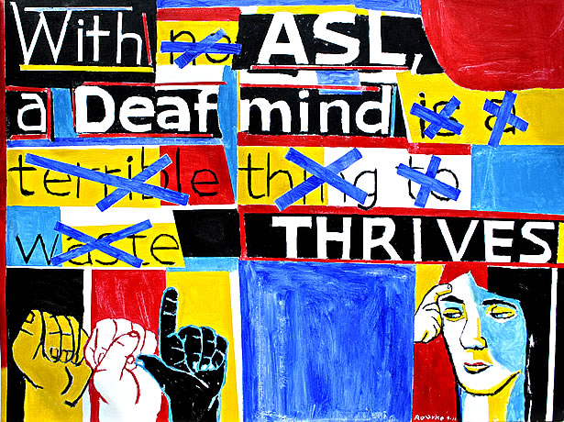
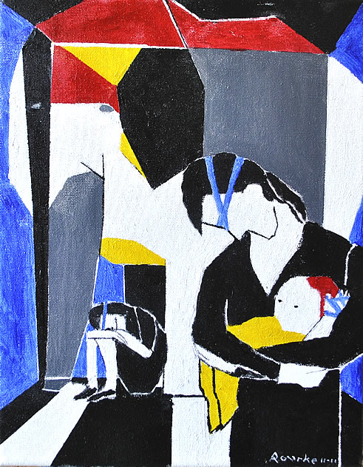
2011
http://www.nancyrourke.com/aslthrives.htm
http://www.nancyrourke.com/elephantinthedeafroom.htm

Slide 20
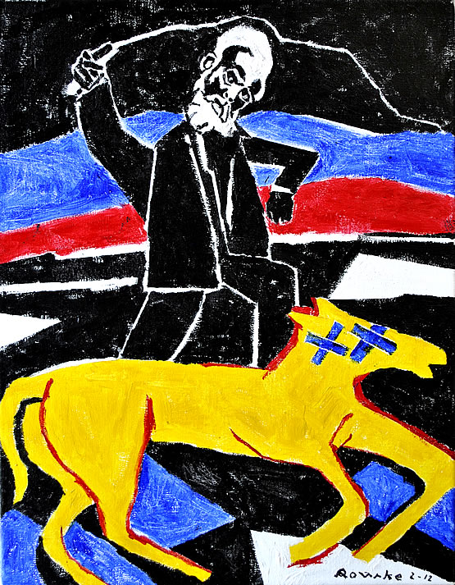
2012 Motifs
Ladder-------------------------------------------- Represents a direction to a new journey. A Deafhood journey.
Horse------------------ Represents a Deaf person needs light to see. With blue tape on a horse, refers to colonialism and audism. (AGB Whips a Deaf Horse)
Notes:
20

Slide 21
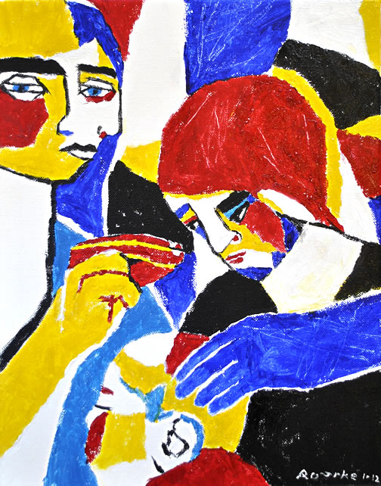
2012
http://www.nancyrourke.com/noeugenics.htm
http://www.nancyrourke.com/agbwhipsdeafhorse.htm

Slide 22
2013 Motifs
Dots/Black Holes-------------------------------------------- Invasion. Attacking. Second wave of Oralism.
12--------------------- Remembering the first 12 nameless children who died from CI complicated surgeries.
Notes:
22

Slide 23
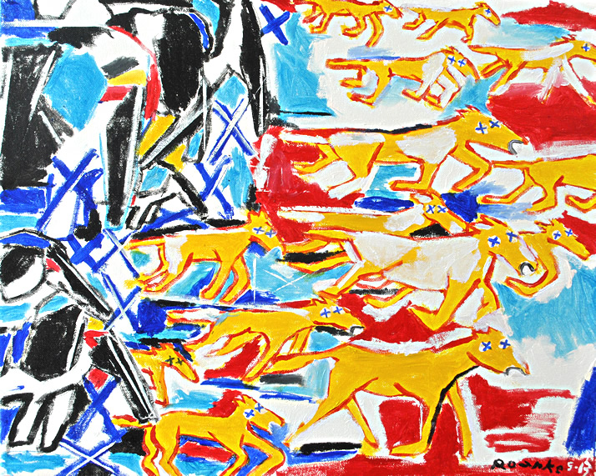
2013

Slide 24
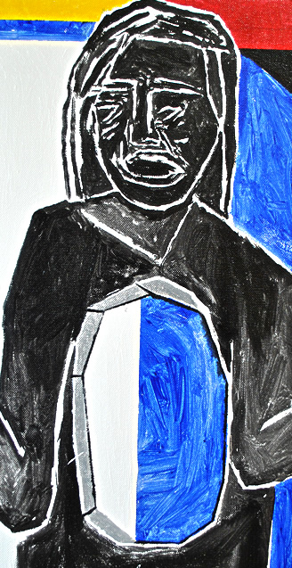
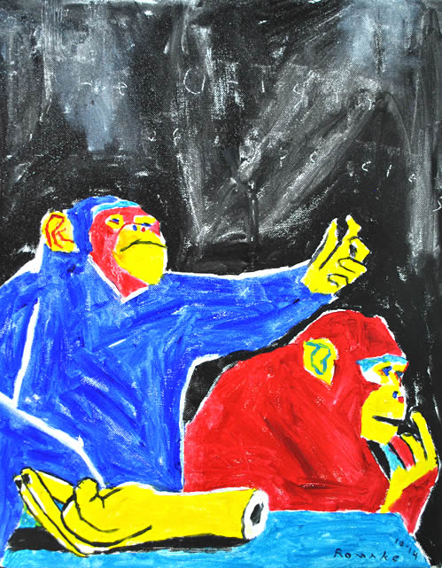
2014 Motifs
Body Hole-------------------------------------------- The motif communicates that the dominant culture has not allowed Deaf people to become fully realized human beings with access to ASL, Deaf culture and a DEAF WORLD view.
Monkey---------------------- Primitive stage of evolution. Social Darwinism.
Black Flag---------------------------- to pay a tribute to the first 12 nameless Deaf children who died from CI surgery complications.
Notes:
24

Slide 25
2014
http://www.nancyrourke.com/socialdarwinism.htm

Slide 26
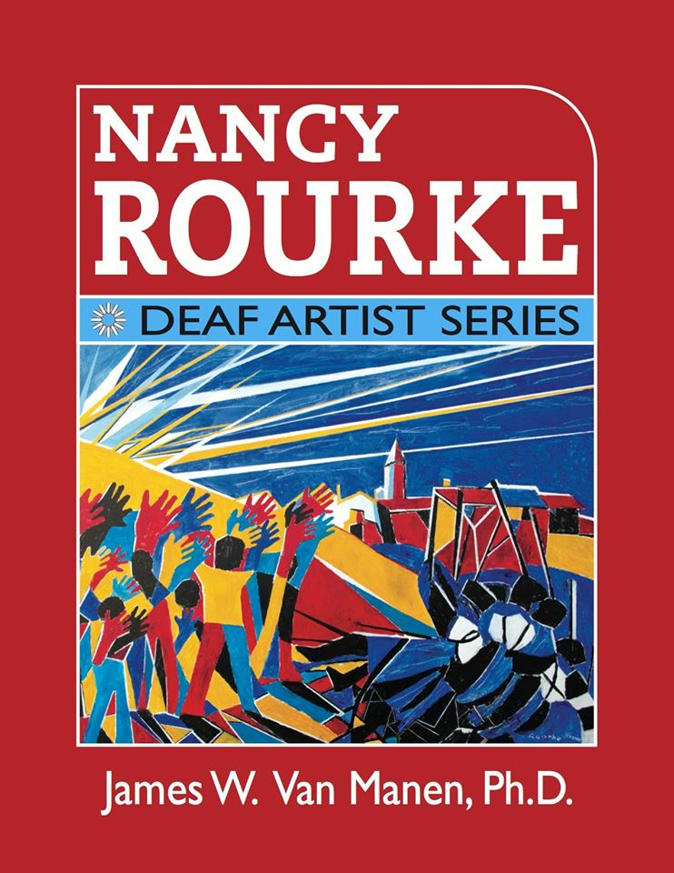
2014
Nancy Rourke: Deaf Artist Series book

Slide 27
2014
The book contains
214 pages
12 chapters
536 images of my paintings

Slide 28
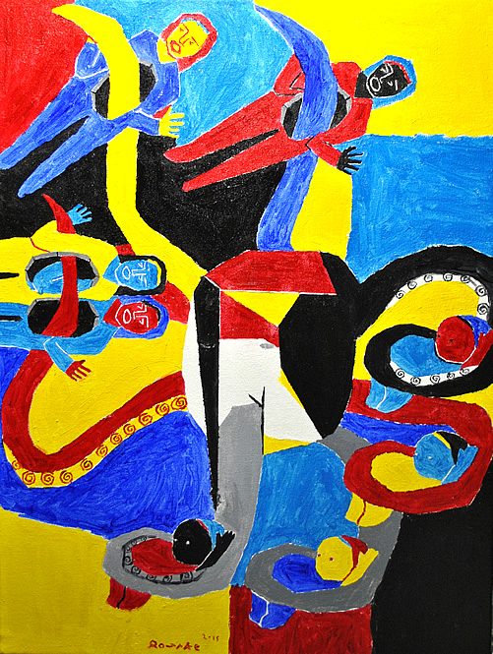
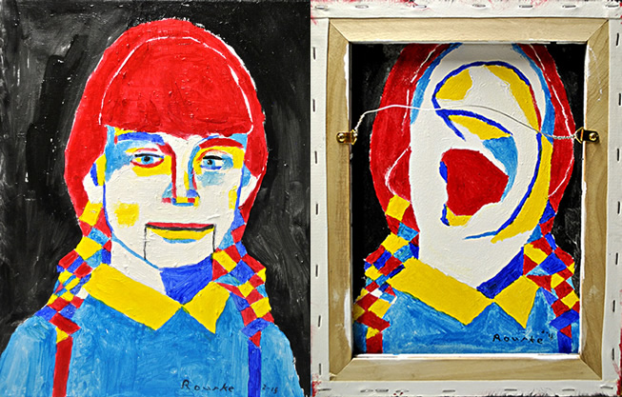
Motifs Used in Paintings 2015
Octopus-------------------------------------------- Captialism. Power. Seize control of Deaf community. AGBell
Two-Way Mirror-- Represents the concepts of being two faced or the idea of having a two-way mirror. Mirrors also reflect the real people hiding behind the mask of benevolence.
Notes:
28

Slide 29
2015
http://www.nancyrourke.com/twowaymirror.htm

Slide 30
2015
28 Days in February Challenge Project
Theme: Solidarity/ARTivism Motifs in resistance and affirmative Day 1 chain, resistance 2 light bulb, affirmative 3 feather, resistance 4 hand, affirmative 5 mirror, resistance 6 handstand, affirmative 7 lock, resistance 8 flower, affirmative 9 profit, resistance 10 butterfly, affirmative 11 jigsaw puzzle, resistance 12 candle, affirmative 13 AGB, resistance 14 ladder, affirmative 15 blue tape, resistance 16 eyes, affirmative 17 hook, resistance 18 tree, affirmative 19 mask, resistance 20 baby, affirmative 21 nails or screws, resistance 22 hands holding, affirmative
677 artworks
55 participants
5 from Europe
23 puppet, resistance 24 solitary fist, affirmative 25 octopus, resistance 26 door, affirmative 27 checkerboard, resistance 28 round table, affirmative Rules 1) Artwork must be completed each day. 2) you can use any medium. Any size of artwork. 3) Do your own creativity. 4) **Must be Deaf Experience.** 5) Post your finished artwork, with title, your name, medium, size, and description on De'VIA Central FB page.

Slide 32
2015
De’VIA Curriculum Development Project at California School for the Deaf Fremont

Slide 33
2010-2015
Artivism

Slide 34
How De’VIA impact Deaf Education:w

Slide 35
Second Wave of De’VIA 2010-present
-ARTivism (Activist + Artist)
-Visual art about our truths
-Media exploring Deaf history, ASL and Deaf life
-ASL literature
-Social Media

Slide 36
Artivism 2010-15

Slide 37
2015
Second Wave of Milan

Slide 38
Contact Information
Facebook Nancy Rourke Expressionist Paintings
Twitter @nancyrourke
Website www.nancyrourke.com

Slide 39
Thank you

